Slide 1
Service with a Purpose: Community Classes That Address Real Needs
Betty Sedor, Director of Community Education, El Camino College
Kendall Harris, Associate Director, Extended Learning, Santa Barbara City College
Betty Sedor, Director, Community Education, El Camino College bsedor@elcamino.edu
Kendall Harris, Associate Director, Extended Learning, Santa Barbara City College keharris1@pipeline.sbcc.edu

Slide 2
CA Education Code 78300
Community Education, also known as Community Services or Continuing Education, is legally defined by California Education Code, section 78300 as:
…classes in civic, vocational, literacy, health, homemaking, technical and general education, including, but not limited to, classes in the fields of visual and performing arts, handicraft, science, literature, nature study, nature contacting, aquatic sports and athletics.
These classes shall be designed to provide instruction and to contribute to the physical, mental, moral, economic or civic development of the individuals or groups enrolled therein.

Slide 3
Adult learning is problem centered. --LERN’s Program Management Institute, 1. Learning and Teaching, Page 7
Help people solve problems.

Slide 4
Needs

Slide 5
Using the flexibility and adaptability of fee-based non-credit programs, target instruction to a designated population with tangible results

Slide 7
Contract Training for the Community

Slide 9
Facilitator, Not just a Provider

Slide 10
Create a dynamic interaction between students and their community

Slide 11
Why Community Education?

Slide 12
Fee-based

Slide 13
Fee-based Flexible

Slide 14
Fee-based Flexible Responsive

Slide 15
Fee-based Flexible Responsive Teacher options

Slide 16
Fee-based Flexible Responsive Teacher options Sponsorship

Slide 17
Fee-based Flexible Responsive Teacher options Sponsorship Access to outside venues

Slide 18
Fee-based Flexible Responsive Teacher options Sponsorship Access to outside venues Class structure

Slide 19
Fee-based Flexible Responsive Teacher options Sponsorship Access to outside venues Class structure Community outreach

Slide 20
Be Part of the Solution

Slide 21
How to Do It?

Slide 22
Determine a specific issue to explore
Project a result from the activity
Identify the audience
Structure the activity
Determine budget
Seek funding

Slide 23
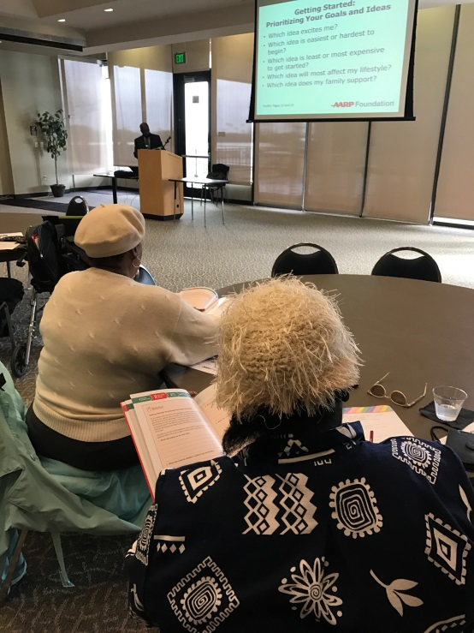
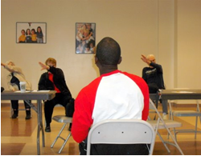
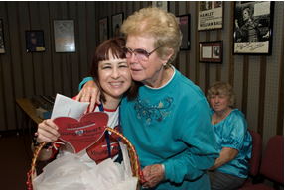
Older Adults

Slide 24
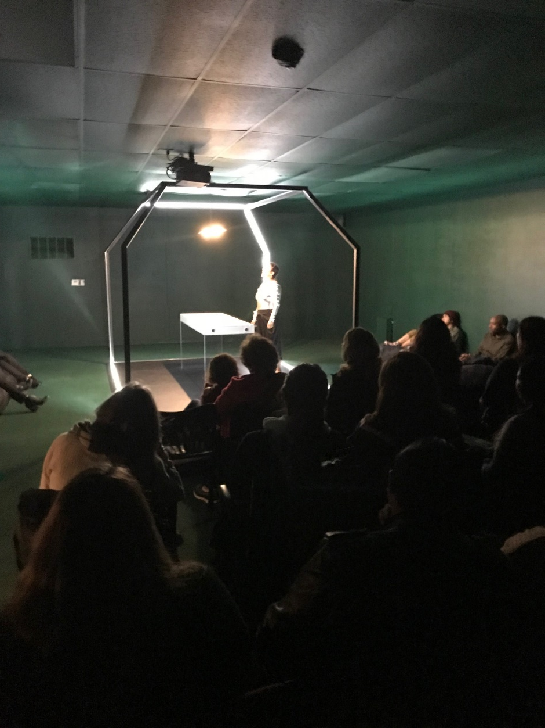
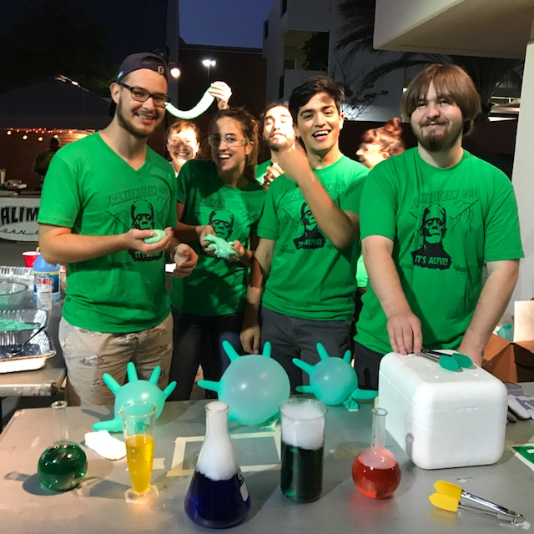
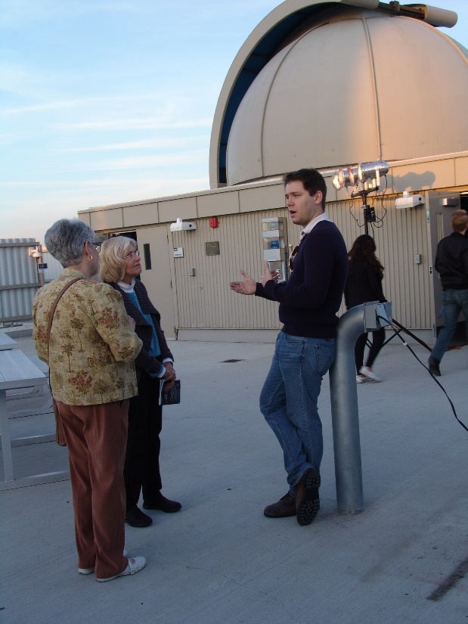
The Entire Community

Slide 25
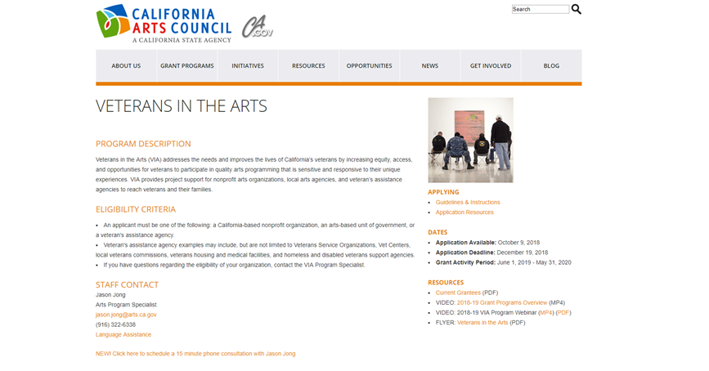
Veterans
Comedy Boot Camp for Veterans
Iconic television shows like M*A*S*H helped pave the way for therapeutic and comedic understanding of difficult topics such as war and military life through the art of comedy.
Therapeutic course for veterans, service members, led by Community Ed comedy instructor.
Provides participants with transferable life skills, a renewed sense of purpose, and an improved sense of well-being while strengthening ties between veterans and community through art.

Slide 26
Who Will Pay For This?

Slide 27
College Foundations
Community Foundations
City Funds
Private sponsorship
Topic specific Organizations
Look for tie-ins
Sharing of responsibility and outcomes

Slide 28
Potential Funding Grants
VETERANS
CA Arts Council, Veterans in the Arts
http://arts.ca.gov/programs/via.php
FIGHT HOMELESSNESS
United Way, Solutions for Homelessness
http://homeforgoodla.org/wp-content/uploads/2017/07/Home-For-Good-Funders-Collaborative-Overview.pdf
CA Community Foundation, Housing--Research and advocacy grants
https://www.calfund.org/nonprofits/what-we-fund/housing/
LGBTQ
https://lgbtfunders.org/resources/issues/education/#topfunders
INCARSERATED
CA Arts Council, Arts in Corrections program
http://arts.ca.gov/news/atcdetail.php?id=1148
YOUTH
CA Arts Council, Youth Arts Action--Youth/After-School & Summer
http://arts.ca.gov/programs/yaa.php
https://www.lacountyarts.org/funding/community-impact-arts-grant-program
ELACC's Young People's Leadership Academy, a year-round afterschool and summer youth program facilitating leadership through arts and culture.
L.A.C.E.R.'s Music Stars programs which includes the Rock Band, Marching Band and Drumline. $14,000
VARIOUS CATEGORIES
LA County Arts Commission, Community Impact Arts Grant
https://www.lacountyarts.org/funding/community-impact-arts-grant-program
Coalition for Humane Immigrant Rights
To support the production for CHIRLA's next film in its Know Your Rights series. $13,000
Casa de las Amigas
To support an arts program for women seeking addiction treatment. $8,000
L.A. GOAL
To support over 60 artists with developmental disabilities to create works of art for the 28th Annual Art Show, to be held in Fall 2018. $14,000

Slide 29
Instead of revenue as the goal, look at community activism, community goodwill as the sustainable results

Slide 30
Learning without thought is labor lost
Thought without learning is perilous

