Slide 1
Hypnotic Writing Juicy Words to Seduce Customers
Presented by: Betty L. Sedor, El Camino College
ACCE Conference, January 31, 2020 Sacramento
Inspired by the book Hypnotic Writing (How to Seduce and Persuade Customers with Only Your Words ) by Joe Vitale

Slide 2
What is Hypnotic Writing?
Nothing is impossible.
Nothing is impossible.
Nothing is impossible.

Slide 3
What is Hypnotic Writing?
It’s not your fault.
It’s not your fault.
It’s not your fault.
Repetition is hypnotic. Repeat your main points.
Just ask Robin William…
http://youtu.be/GtkST5-ZFHw

Slide 4
What is Hypnotic Writing?
Writing that is so clear and concise and effective that you can’t resist reading it.
Writing that gets you to remember--and act--on what you’ve read.
Spellbinding…
Unforgettable…
Filled with embedded commands.
Intentionally using words to guide people into a focused mental state where they are inclined to register for one of your classes!

Slide 5
Waking Hypnosis
Turning our students into Community Ed Zombies!
Enticing our customers with language that puts them into a “buying” trance…
“When hypnotic effects are achieved without the trance state, such hypnotic effects are called waking hypnosis.” –Hypnotherapy, Dave Elman
It’s not magical or mystical!
It’s a walking trance!
Just like being absorbed in a good movie…
Just like being riveted by a good book…
Just like “zoning out” while taking a long relaxing scenic drive…
Just like compulsive shopping…

Slide 6
Product Description
The unique metal ball-point pen with built-in massage
Rugged metal construction.
Attractive design.
Patented massage function.
Replaceable ink refills.
Batteries included.
Well, is that Hypnotic Writing?
I don’t think so.
A Massage Pen

Slide 7
Revised Product Description
IMAGINE you had a teensy-weensy masseuse to carry around in your shirt pocket. Any time you desired, you could order your mini masseuse to soothe your tired muscles and rub away your tensions. Now imagine this tiny masseuse had a pen sticking out of his head and ran on batteries. Well, you’re not likely to come across a miniature, pen-headed masseuse—but here’s the next best thing. Introducing the world’s first MASSAGING PEN!
Is that Hypnotic Writing?
You bet!
A Sexy Massage Pen

Slide 8
Two Ways to Cause Action
#1 Pain--Move Away From What You Don’t Want
Got migraines?
#2 Pleasure--Move Toward What You Want
Girl scout cookies instantly relieve migraines!
Most sales oriented writing answers these questions:
Are you getting attention with your opening?
Are you stating a problem the reader cares about?
Are you offering a solution that really works?
Are you asking the reader to take action?

Slide 9
Promise * Proof *Price
Promise
How to play any song you love on the guitar—in one weekend flat!
Proof
The Stripped-Down Guitar class will reveal to you clear and concise stripped-down secrets that will have you playing the guitar by the end of the weekend!
Price
Enroll now! Limited class size for optimum learning. $39

Slide 10
How To Jump Start The Muse
Just Begin –Gibberish will turn into wisdom.
Don’t Edit –Write it down first, later get it right.
Write A Letter –A lot of hypnotic writing shows up in personal letters. We become self-conscious when we write for the public, so write everything as personal letter. Edit out the mush later.
Use A Prompt –Create a list or prompt words/openings/commands. Prompt words prompt you into another thought. Try it! See: “The 20 Most Powerful Words In Advertising”
Relax – “Don’t play the saxophone. Let it play you.” –Charlie Parker
Don’t write. Let the writing write you . The muse like to visit relaxed writers.

Slide 11
Muse Tips from the masters!
Ray Bradbury would free-associate on paper each morning until an idea clicks. Write whatever comes to mind. Sooner or later you’ll stumble across a rich vein and you’re off and running. Gibberish can turn into wisdom!
Ray Bradbury would write a story every day, never knowing what he would write until after he had written it.
Eugene Schwartz, a famous copywriter would set a time and write in 33 & ½ minute spurts.
Jack London disciplined himself to write 1,000 words every morning, whether he knew what to write or not.

Slide 12
How to Make Your Writing Walk, Talk, and Breathe Dragon Fire
Use A Thesaurus– Use your thesaurus to make your writing simple and direct. If you have a long word, hunt down a shorter one.
Use A Simile Book—A phrase to compare two different ideas. A simile can give your reader a nice jolt! Gush out like toothpaste.
Use A Book Of Analogies--The Analogy Book of Related Words by Selma Glasser
Use A Book of Quotes—Words have power. Words in a quote can be powerful enough to alter the world. Whoever said the pen is mightier than the sword wasn’t lying.

Slide 13
How To make your writing sexy
Four Ways To Make Your Writing More Inviting
Use bullets--Dot, star or asterisk. Reader’s love em’!
Use quotes—Put something in quotation marks an it’ll be read before anything else. Why? Because people are interested in people.
Use itsy-bitsy paragraphs—Break up your paragraphs into one or two lines. Stagger their length.
Use boxes– People read whatever you put into a box.
Yes, you can make your class descriptions “sexy.” These tips will work every time. Try is and see.

Slide 14
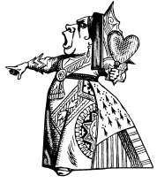
LERN TIP
AIDA Is Not A Sexy Woman, But She Works!
A Attention --- GRAB IT
I Interest—Peak it
D Desire—Create It
A Action—Inspire it
Be bold, use active words and phrases, focus on WIFM
Testimonials
Pictures
Positive versus negative words are so important, even on copy like registration forms.
Bonus: Have a 14 year old read it.

Slide 15
The One Hypnotic command that always works
Know the exact one thing your prospects want and tie everything you say to it.
A good hypnotist will simply issue a command, “When I count to three, you will close your eyes” or “When I snap my fingers, you will bark like a dog.”
If you give your students too many “reasons why you should register for a class” you risk boring them, overwhelming them , or irking them.
Focus on the one thing your students want most by enrolling in that particular class. Whatever that is, create your hypnotic command based on it.

Slide 16
30 ways to write a hypnotic headline
Lead with exciting opening words. “New!”
Round up your audience. “Attention Lifelong Learners!”
Promise a benefit.
Make it newsworthy.
Offer something free.
Ask an intriguing question.
Lead with a testimonial.
Create a “how to” headline
Quiz your readers.
Use the words “these” and “why” in your headline.
Use “I” and “me” headlines.
Put your class topic in your headline
Use the word wanted.
Use the word breakthrough in your headline
Set your headline in upper and lower case.
Use as many words as you need.
Feature your offer.
Ask “who else?”
Use a guarantee.
Admit a weakness.
Focus on positive end results.
Warm your audience.
Be careful with humor.
Make it easy.
Be careful with reverse type.
Dramatize the benefit.
Use proven cliches.
Reveal a hidden benefit..
Give reasons.
Use a before-and-after-statement

Slide 17
5 Secret laws of hypnotic persuassion
Engagement—Ask questions. Ask them to complete a task. The more your engage, the more inclined they will be to enroll in one of your classes.
Choice—Two options—to choose between, gives students a sense of control.
Ego—Stroke their ego, but sincerely. Don’t lie. Don’t mislead. We all want flattery. You. Me. Our instructors. Our students.
Reward—Reward people who register for your classes. Give them thanks, discounts, parking directions/secrets. This creates value, removes buyer’s remorse , and strokes the ego.
Curiosity—Ask an inquisitive “curious” question. Do you know how many different types of Pharmacy Technician work environments there are? Open a student’s mind—engage them.

Slide 18
The Hypnotic writing formula
STOPPER!
Get their attention!
Trance them… Make them your Community Ed zombie.
Reel them in!
Promise/Benefit/Curiosity
Build Desire/ Emotion!
Paint the picture.
Tell the story.
Pain or Pleasure.

Slide 19
The Hypnotic writing formula
Give reasons!
Appeal to logical thinking.
Explain/Develop.
Dialogue!
Respond to objections.
Proof!
Facts, statistics, testimonials
Mind reading.

Slide 20
The Hypnotic writing formula
Guarantee!
Risk reversal—No buyer’s remorse!
Action!
Ask for the sale.
Reminder/Closer
Repeat main points.
P.S. Pain/Pleasure/Gifts
Enroll now! Call 310-660-6460 www.ECCommunityEd.com

Slide 21
Rewriting Tips
Stephen King’s Advice: Make 10 copies of your [course description or ad], hand out to 10 peers (not family members!). When their feedback comes in, look for the majority votes.
Whenever you see a comma, see if you can change it to a period. Creating shorter sentences will make your writing move.
Read your writing out loud. When you speak your words, you are forced to slow down and become more aware of them.
Ask yourself, “Where will someone probably skip a section in my writing?” Don’t be boring! Trust your intuition. If it’s bad, boring, or blah writing… Delete it, move it, break it up into smaller sections, or rewrite it.

Slide 22
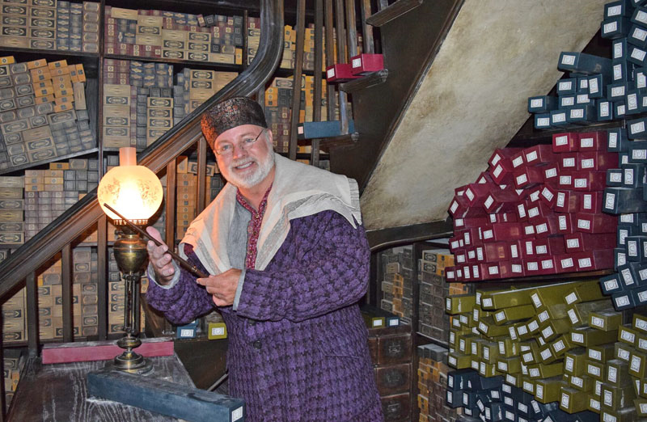
Writing GaMe
#1: The Professional Development Class
Write a hypnotic course description for a…
Magic Wand Job Training

Slide 23
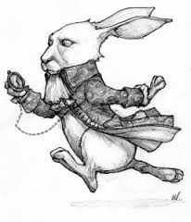
Writing GaMe
#2: The Personal Development Class
Write a hypnotic course description for a…
Time Mangement Class
“I'm late / I'm late / For a very important date.”
-- Lewis Carroll Alice in Wonderland

Slide 24
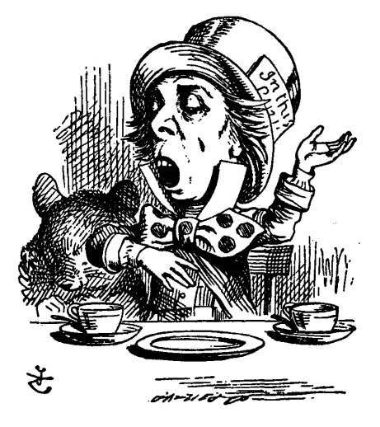
Writing GaMe
#3: The Kids Class
Write a hypnotic course description for a…
Mad Hatter Class

Slide 25
CERTIFICATE OF HyPnotic
Awarded to
For successful development of the juiciest-worded class description at:
Hypnotic Writing: Juicy Words to Seduce Customers
2020 ACCE Workshop: January 31, 2020
_____________________________________________________
ACCE 2020 Workshop Presenter

