Slide 1
Generation Z What the …?
Sandra Reese
Principal, Pioneer High School
Woodland Joint Unified School District

Slide 2
Who am I, and why listen to me?
27+ years with High School Students
6 years as a High School Vice Principal (THAT’LL learn you!)
8 years as a comprehensive High School Principal
Coordinator Graduate Profile Design Team - WJUSD
Sandra Reese
Sandra.Reese@wjusd.org

Slide 3
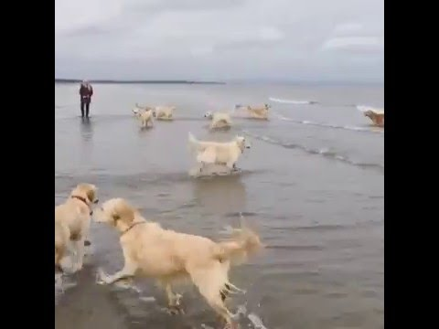
In other words, I’m SO excited that you are willing to listen to someone who cares DEEPLY about these kids!
Which one is me today???

Slide 4
What’s your mindset?
Stay with me a sec…
WHY do we have students write X paragraph essays?
Talk with a neighbor for a moment...
Notes:
Have participants discuss this. Now… How often once we finish schooling do we run and write a 5 paragraph essay? Are kids on to us?

Slide 5
Meet Ellie!

Slide 6
Quick area/partner talk
In this video, Ellie is 16 months old. She is now in 2nd grade. What can she do now? What will she be able to do by the time she enters high school? Post high school?
Compare with each other how old you were when you first got a cell phone? Smart phone? What does this mean about our technological “smarts” as compared to our students’?
Effective communication, curiosity, and critical-thinking skills are much more than just the traditional outcomes of a liberal arts education. They are essential competencies and habits of mind for life in the 21st Century.
-The Global Achievement Gap

Slide 7
The Paradigm
Are you ready for the shift?
There is a profound disconnect between what students are taught and tested on in most high schools today and how they are expected to learn, versus what the world will demand of them as adults and what motivates them to do their best.
-The Global Achievement Gap

Slide 8
Consider…
I wonder how much deeper the ocean would be without the sponges...
“Kids today don’t read, and they don’t do their homework. I cover all the standards in class, but if they don’t read the textbook, they’ll do poorly on the tests.”
“Kids don’t seem able to identify what is and is not reliable from the Internet. If it’s on the Internet, it must be true, they think. “
“They don’t proofread their papers. It’s as if they think spell-check will catch everything for them.”
Notes:
WHY do some of these things seem different? What are we doing to make info relevant

Slide 9
Now, let’s talk “how it’s always been”…
I went to a Tourist Information Booth and said, “tell me about some of the people who came here last year.”
-Steven Wright
When you were in school…
How often were you asked to EXPLAIN something?
How often did you work in groups?
How often were you told why something was needed/important?
Think graphing a line
Remember that question about an essay?
Notes:
In “Growing up Digital,” John Seeley Brown says “The real literacy of tomorrow entails the ability to be your own personal reference librarian – to know how to navigate through confusing, complex information spaces and feel comfortable doing so. Navigation may well be the main form of literacy for the 21st century.”

Slide 10
What about now?
Check out your search history. How do YOU get info? Here’s mine over the last two days:
Using the GE Profile probe function
Luciano Pavarotti
Best places to stay in Barcelona
Lobster meat recipes
Star Trek Discovery Season 3 Release Date
How many ounces in ¼ cup?
Funny Text Messages
Where did “cat’s got your tongue” come from?

Slide 11
C’mon, Sandi, what’s your point?
“The worst time to have a heart attack is during a game of charades.”
-Demetri Martin
Kids GET info differently than you did.
Kids NEED info delivered to them in different ways than you got (I’m going to posit we have always needed it…)
Kids need SKILLS and COMPETENCIES more than they need information.

Slide 12
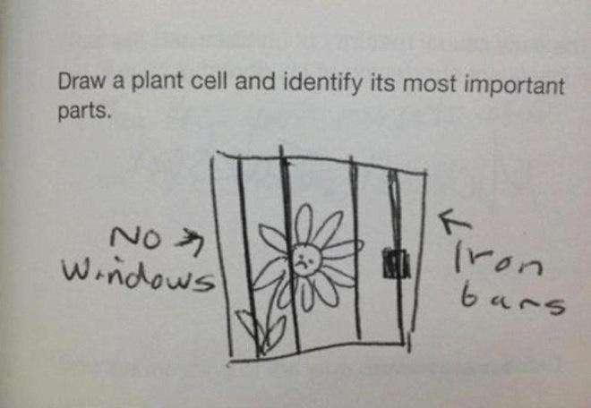
The New Now
Who are we sending you?

Slide 13
Kids who are connected
Multi-taskers
Microsoft calls it Continuous Partial Attention. They are used to quickly checking and responding to information, texts, etc.
Instantly Gratified
Accustomed to being able to find anything anytime; get immediate responses and address anything digitally.
Digital Natives
There is no “before” for them. They have grown up with digital devices and connections.

Slide 14
Kids who have new learning styles
Multimedia Learners
They are not used to merely interacting with text. Think about manuals, directions, lectures, etc.. To tap into students, they need a graphic/visual approach.
Discovery Learners
Learning is a non-linear, active and dynamic process full of “rabbit holes” that they don’t see as wastes of time.
Learners Who Create
They jump into new situations to figure it out. They are setting up Snap Chats, IG, Tik Tok, and using them in new, innovative ways.
“The single biggest problem facing education today is that our Digital Immigrants instructors, who speak an outdated language, are struggling to teach a population that speaks an entirely new language.”
-Prensky, M. Digital Natives, Digital Immigrants. On the Horizon.

Slide 15
Kids who collaborate
Communicators
The course of their days involve communication modes never dreamt of before. This creates a hunger for it in Gen Z kids. They WANT that connection with others.
Kids who “talk tech”
They collaborate via technology. They use Google as a matter of course, and consult online.
They EXPECT it
In nearly every class, they are expected to “turn to a shoulder partner” or share ideas and work together on projects. They like it that way,

Slide 16
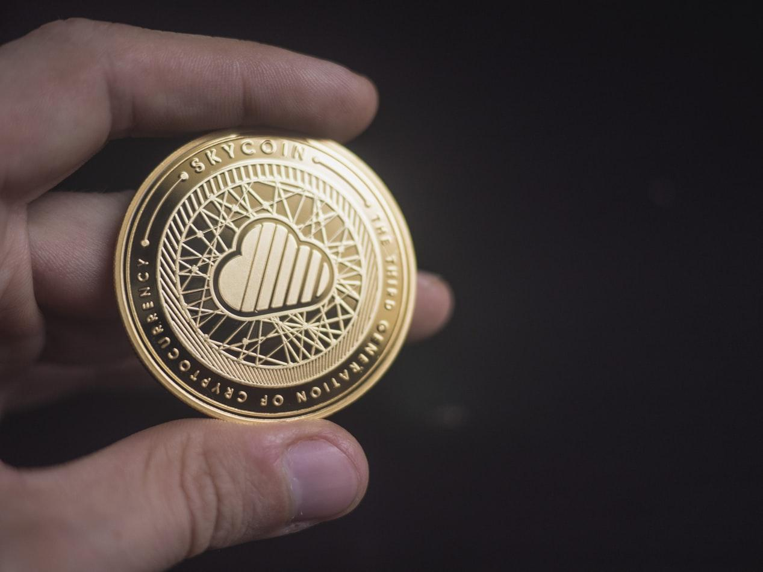
Workers for Tomorrow
So, Gen Z is differently motivated. What are the implications for employers/post-high school?
Employers/teachers as coaches
Input is respected
Social interaction is needed
“Making people” to make things
And… umm… they are snowflakes.

Slide 17
What is the new
thinking?
If pro and con are opposites, wouldn't the opposite of progress be congress?
Life Skills
=
Job Skills
=
College Success Skills

Slide 18
The Graduate Profile
Making the shift from knowledge to skills
Unlike a mission or vision statement, a graduate profile is a document that a school or district uses to specify the cognitive, personal, and interpersonal competencies that students should have when they graduate.
Notes:
Talk about why….

Slide 19
What we did/will do...
Revamp & Infuse Curriculum
From K to 12, all curriculum/lessons/instruction must infuse the skills and competencies of the Grad Profile.
3
Align Mission & Vision
Once the Grad Profile is identified, the district’s mission and vision must align. Our GOAL is to graduate students who demonstrate the skills and competencies outlined by our Graduate Profile
2
Build the Profile
We went to ALL stakeholders to assess and measure what they believed are the most important skills and competencies. Using all the feedback, we built the profile for our district (and community).
1

Slide 20
Here is what we asked...
Procrastination is awesome. You always have something to do tomorrow, plus you have nothing to do today!
What are the hopes, aspirations, and dreams that our community has for our young people?
What are the skills and habits of mind that our children need for success in this rapidly changing and complex world? (Have YOU asked this?)

Slide 21
Who did we ask?
Why isn’t phonetic spelled the way it sounds?
Students
Former Students
Parents
Teachers/Administrators
Staff/CSEA
PTAs/ELACs/DELAC
Community organizations (Rotary, Forums, etc.)
Faith Organizations

Slide 22
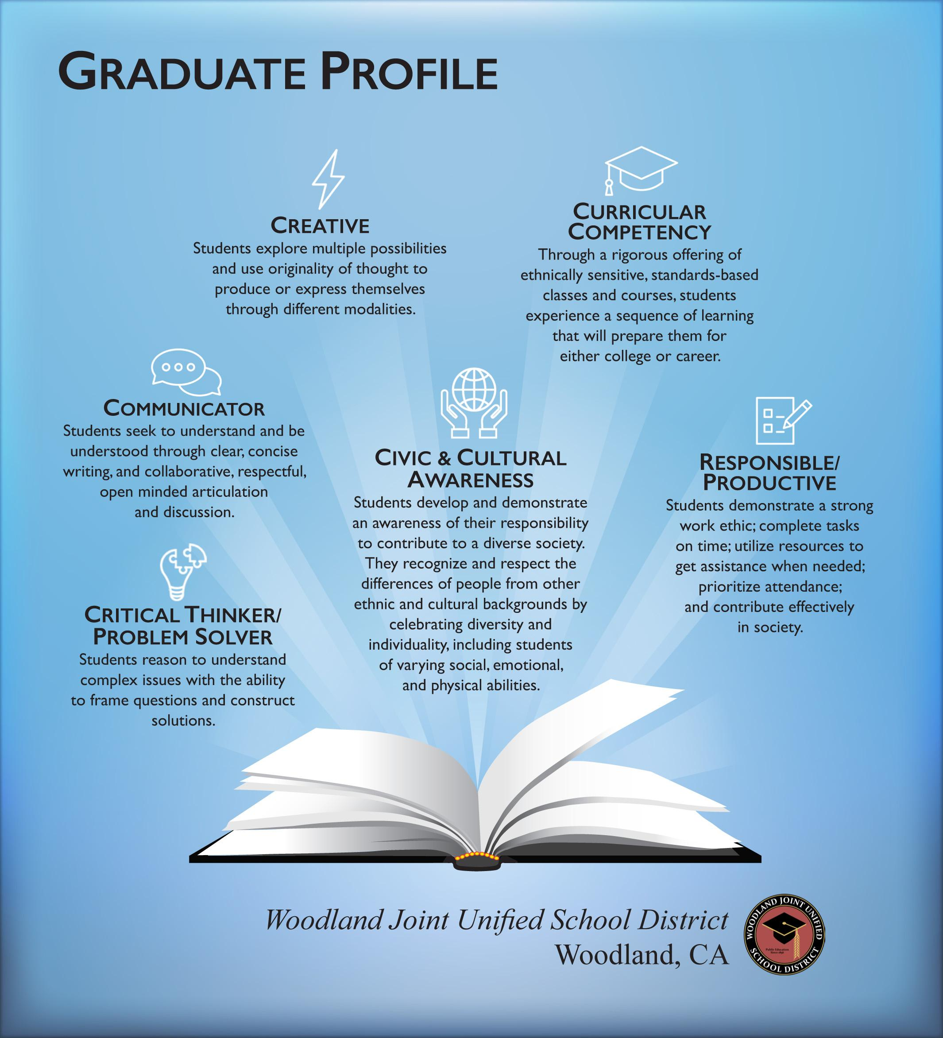
WJUSD
Graduate Profile

Slide 23
What are the implications for you??
Nurture their passions
Build in frustration - Challenge but support
Provide an outlet for their need to be social
Collaborate, collaborate, collaborate
Relate authentically - not from power
Offerings need to incorporate SKILLS and COMPETENCIES
Know how they communicate

Slide 24
And...
Will folks who attend the Academy for the new Space Force be called Space Cadets?
Employers now say that the single most important skill they will look for in their workers is their ability to think critically. And likewise, poor communication skills is the number-one problem with their new employees.
Notes:
What are the implications? You cannot focus on skills at the expense of soft skills

Slide 25
Thanks!
?
Any questions?

