Slide 1
The Building Blocks of Marketing

Slide 2
Community Education: The Building Blocks of Marketing
Website Marketing
Creating a web of inter-connected marketing strategies that broaden our reach through direct contact, digital communications, and online content building via multiple avenues of engagement leading to higher Google and search engine rankings, as well as, customer brand awareness and loyalty.
Social Media
Email Marketing
Events & Contests

Slide 3
Community Education: The Building Blocks of Marketing
Our Social Media & Internet Marketing Partners

Slide 4
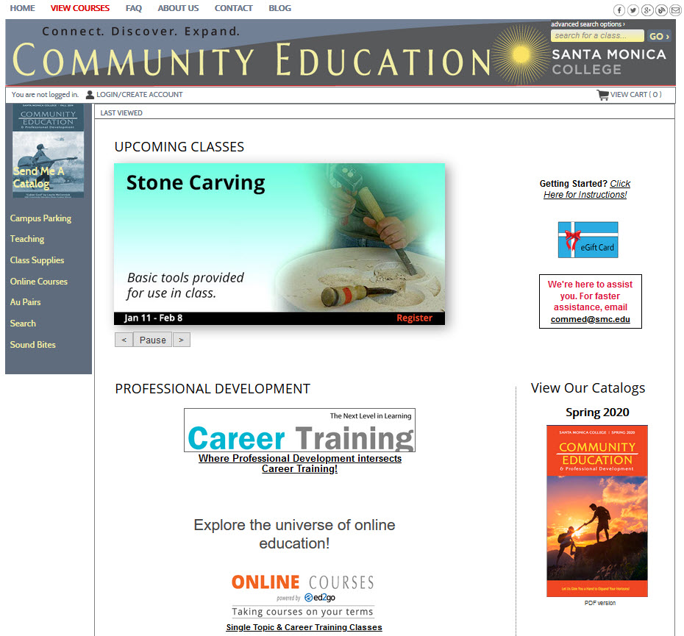
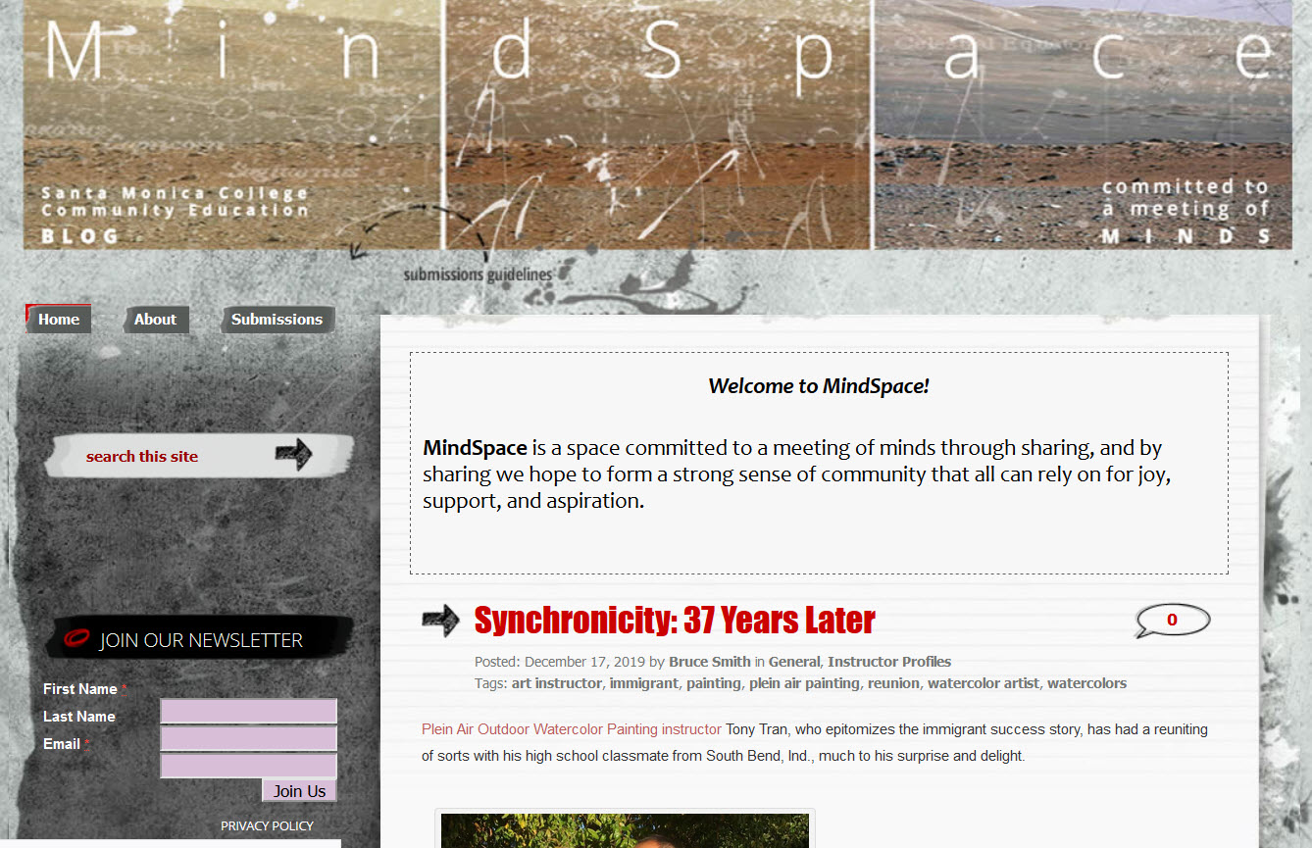
Internet Marketing
Website: commed.smc.edu Blog: smcmindspace.com

Slide 5
Internet Marketing
Website: commed.smc.edu
Marketing Use
Slideshow
Content and pages to market courses
Class schedule (pdf)
Informational
FAQs
Teaching/au pairs/Misc.
Archive for Sound Bites, our online magazine

Slide 6
Internet Marketing
Blog: smcmindspace.com
Marketing Use
Repurpose Sound Bites articles as blog posts
Information
Special Announcements
Community Interaction
Open submissions
Commenting on articles

Slide 7
Social Media
Facebook Twitter

Slide 8
Social Media
http://bit.ly/CE-fb
facebook
Increase web exposure
Class and event updates
80/20 rules

Slide 9
Social Media
http://bit.ly/CE-twitter
Twitter
Web exposure
Widen outreach to different crowd

Slide 10
Email Marketing
Monthly Class Updates—Constant Contact; targeting different groups
Monthly e-newsletter (Sound Bites)
Now Bi-Monthly
Annual Events, Contests & Promotions

Slide 11
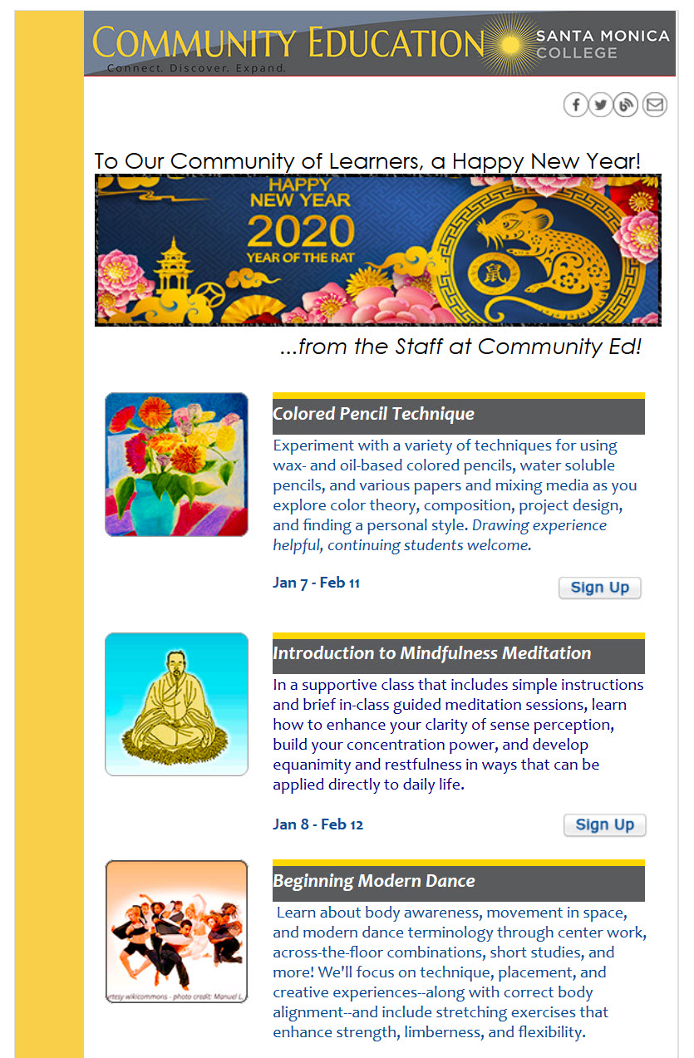
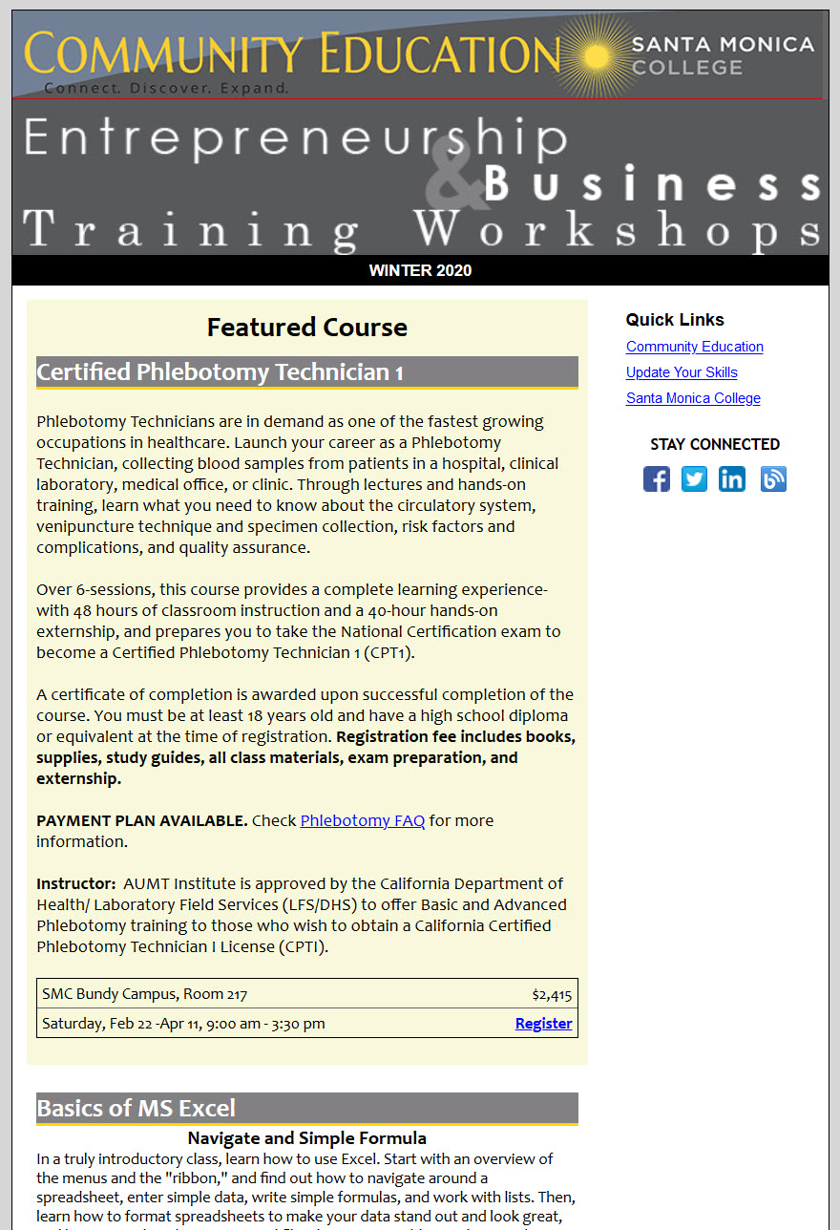
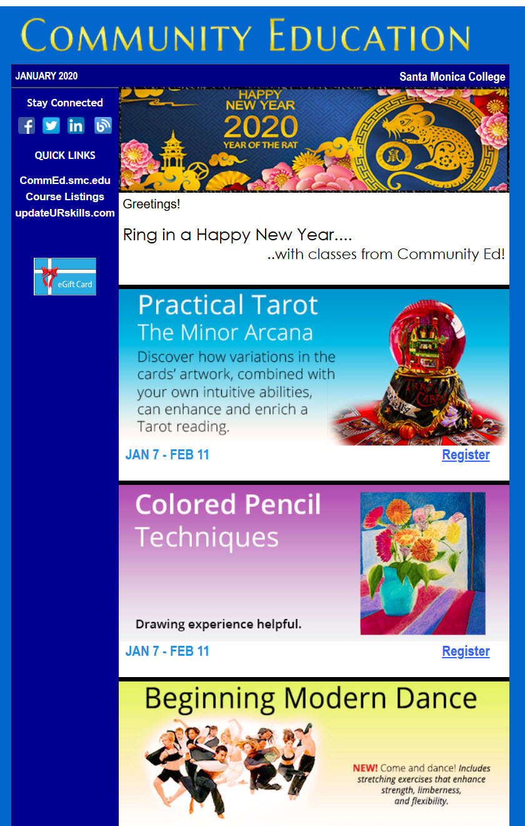
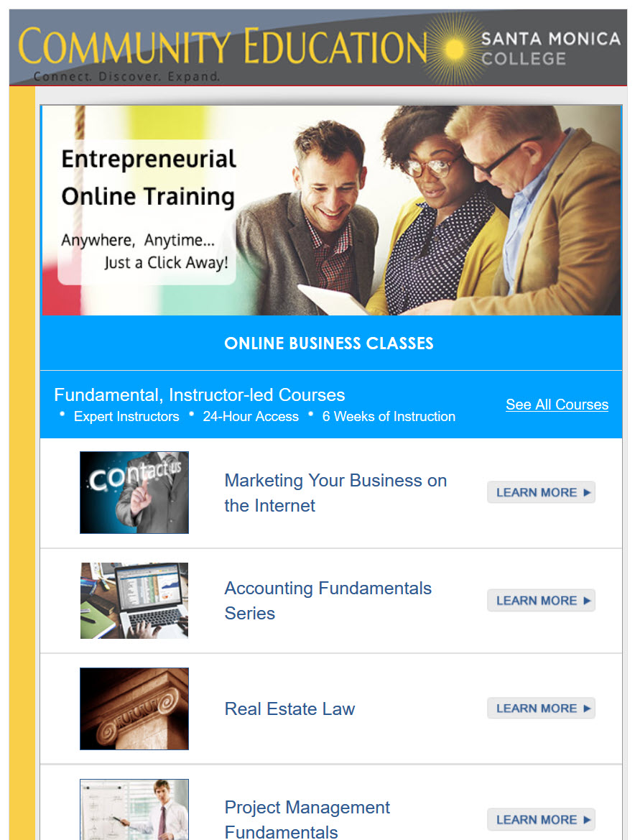
Email Marketing
Monthly Course Updates:
General students
Business students
CourseHorse students
Ed2Go online-targeted

Slide 12
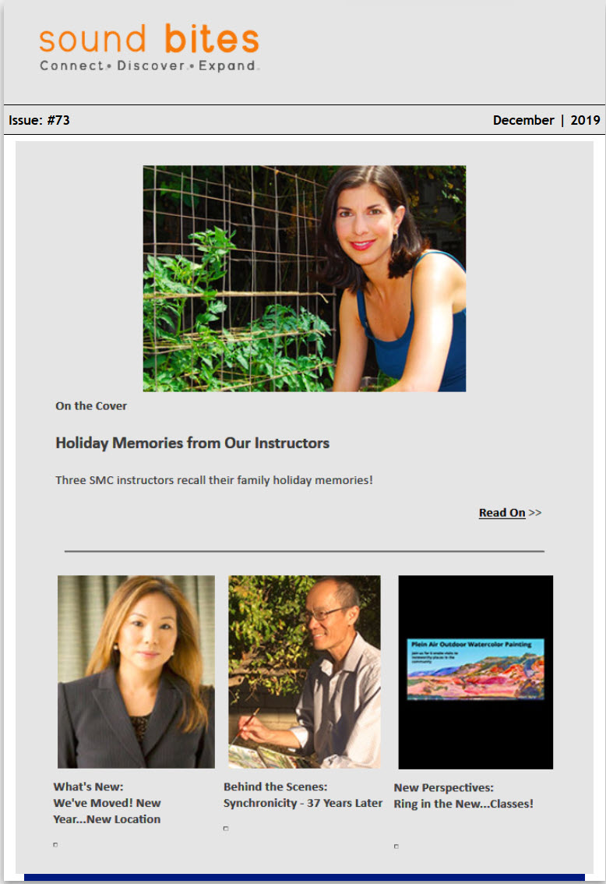
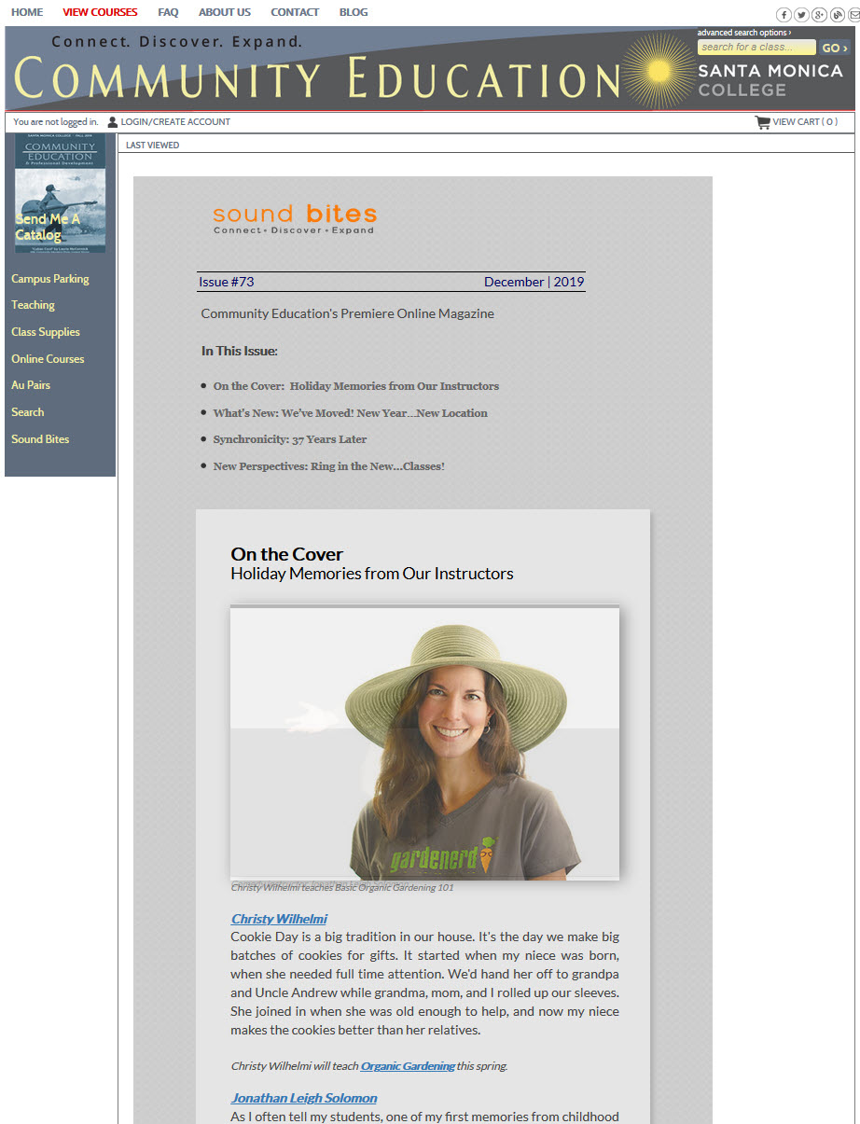
Email Marketing
E-Newsletter:
Sound Bites Newsletter & Landing page
Email
Landing page

Slide 13
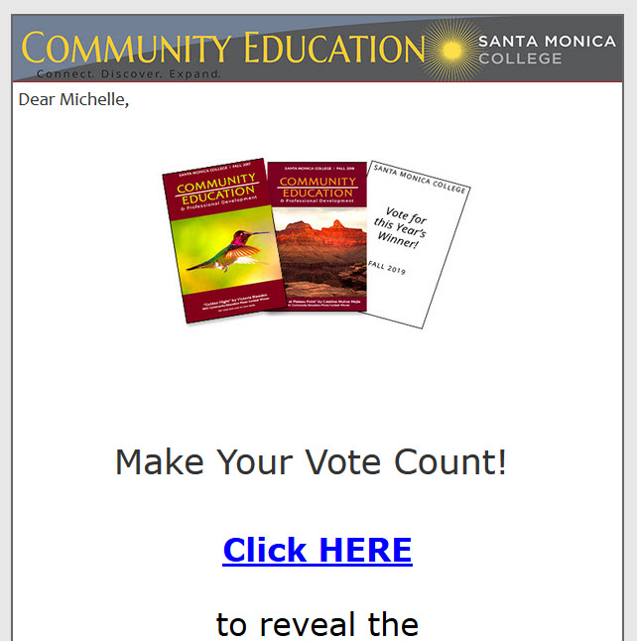
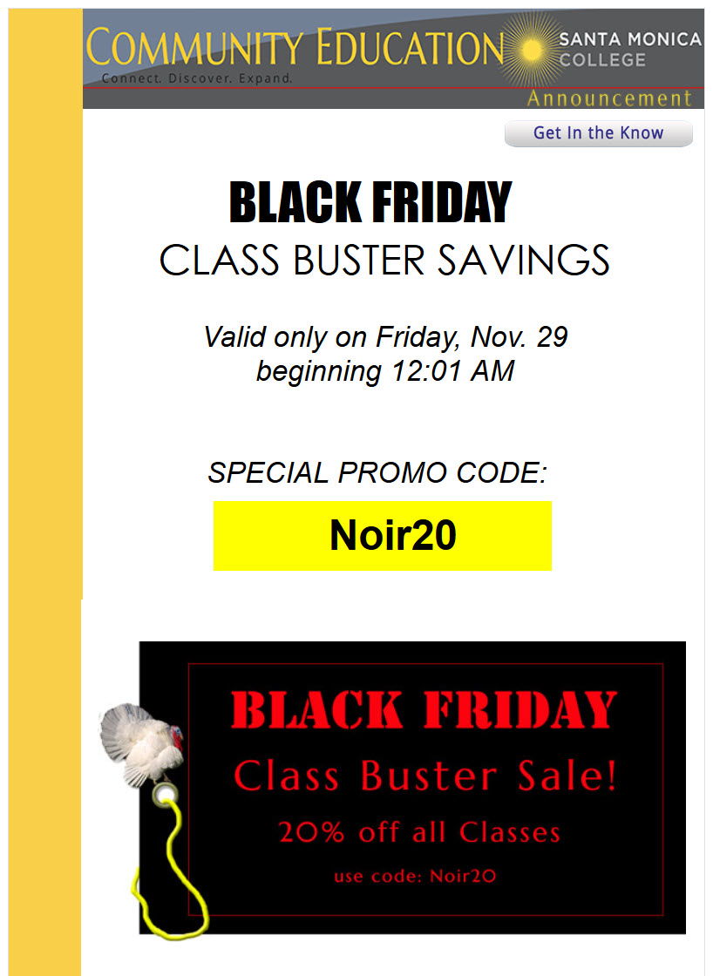
Email Marketing
Special Announcements
Events: Open House
Contest: Photo Contest
Promotions:
Black Friday/Cyber Monday

Slide 14
Email Marketing
Building Email Lists
Web email registration forms
Class schedule requests
Class registration lists
Ed2Go students
CourseHorse students

Slide 15
Events, Contests & Promotions
Special Announcements
Events: Open House
Contests: Photo Contest
Promotions:
Black Friday; Cyber Monday

Slide 16
Events
Open House
Meet & Greet—Instructors meet Public
Class Presentations
Community Engagement

Slide 17
Contests
Photo Contest
Showcase our photo classes
Free cover for Fall/topics for newsletter
Community Engagement

Slide 18
Promotions
Promotions/Discount
You must have a purpose…
Black Friday (aim to boost Winter)
Cyber Monday (aim for those who missed out)
Annual Open House (aim to boost Spring)

Slide 19
Community Education: The Building Blocks of Marketing
A Special Thanks to PJ Abode, our Web Designer, for putting this PowerPoint presentation together, and being my partner-in-crime for helping me execute most of these marketing ideas.

