Slide 1
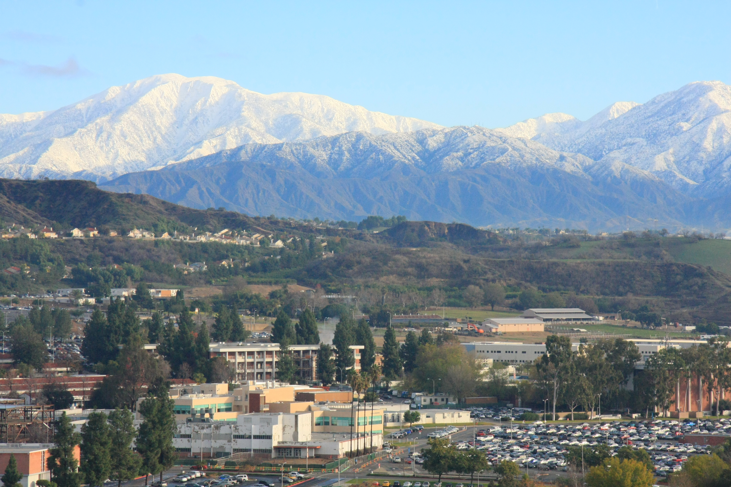
Mt. San Antonio College
Notes:
Campus from the air

Slide 2
Welcome Tips and strategies to increase enrollment in your programs Paulo Madrigal pmadrigal@mtsac.edu (909) 274-5234
Notes:
We are knows as Mt. SAC

Slide 3
My Childhood Comics Hero

Slide 4
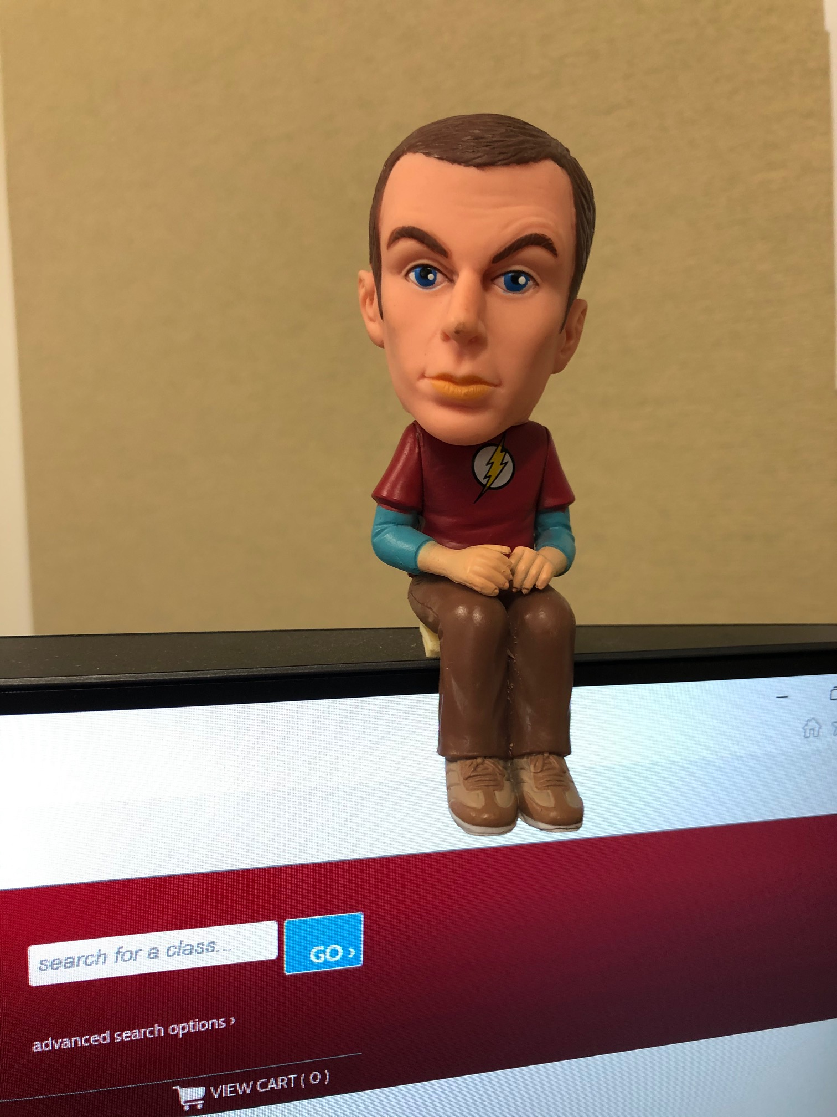
My “almost” Adult (comedy) Hero

Slide 5
Our job is NOT An Easy Job

Slide 7
My Goals for Today
Share our experience: Successes and struggles
Hear your stories
Brainstorm possible ideas to enhance enrollment

Slide 8
External forces and the environment can and will impact our programs
Phlebotomy
International Camps
English for the California Visitor

Slide 9
Adding Enrollment Advertising CEUs
Principles of Computed Tomography: ASRT (American Society of Radiologic Technologists)
Water Technology: SWRCB (State Water Resources Control Board)
Nurse Assistant Certification & Home Health Aides CNA/HHA: CDHP (California Department of Public Health)
Language Courses: Advanced Hindi
Welding: County of Los Angeles (Other Counties as well)
Motorcycle: CHP/DMV

Slide 10
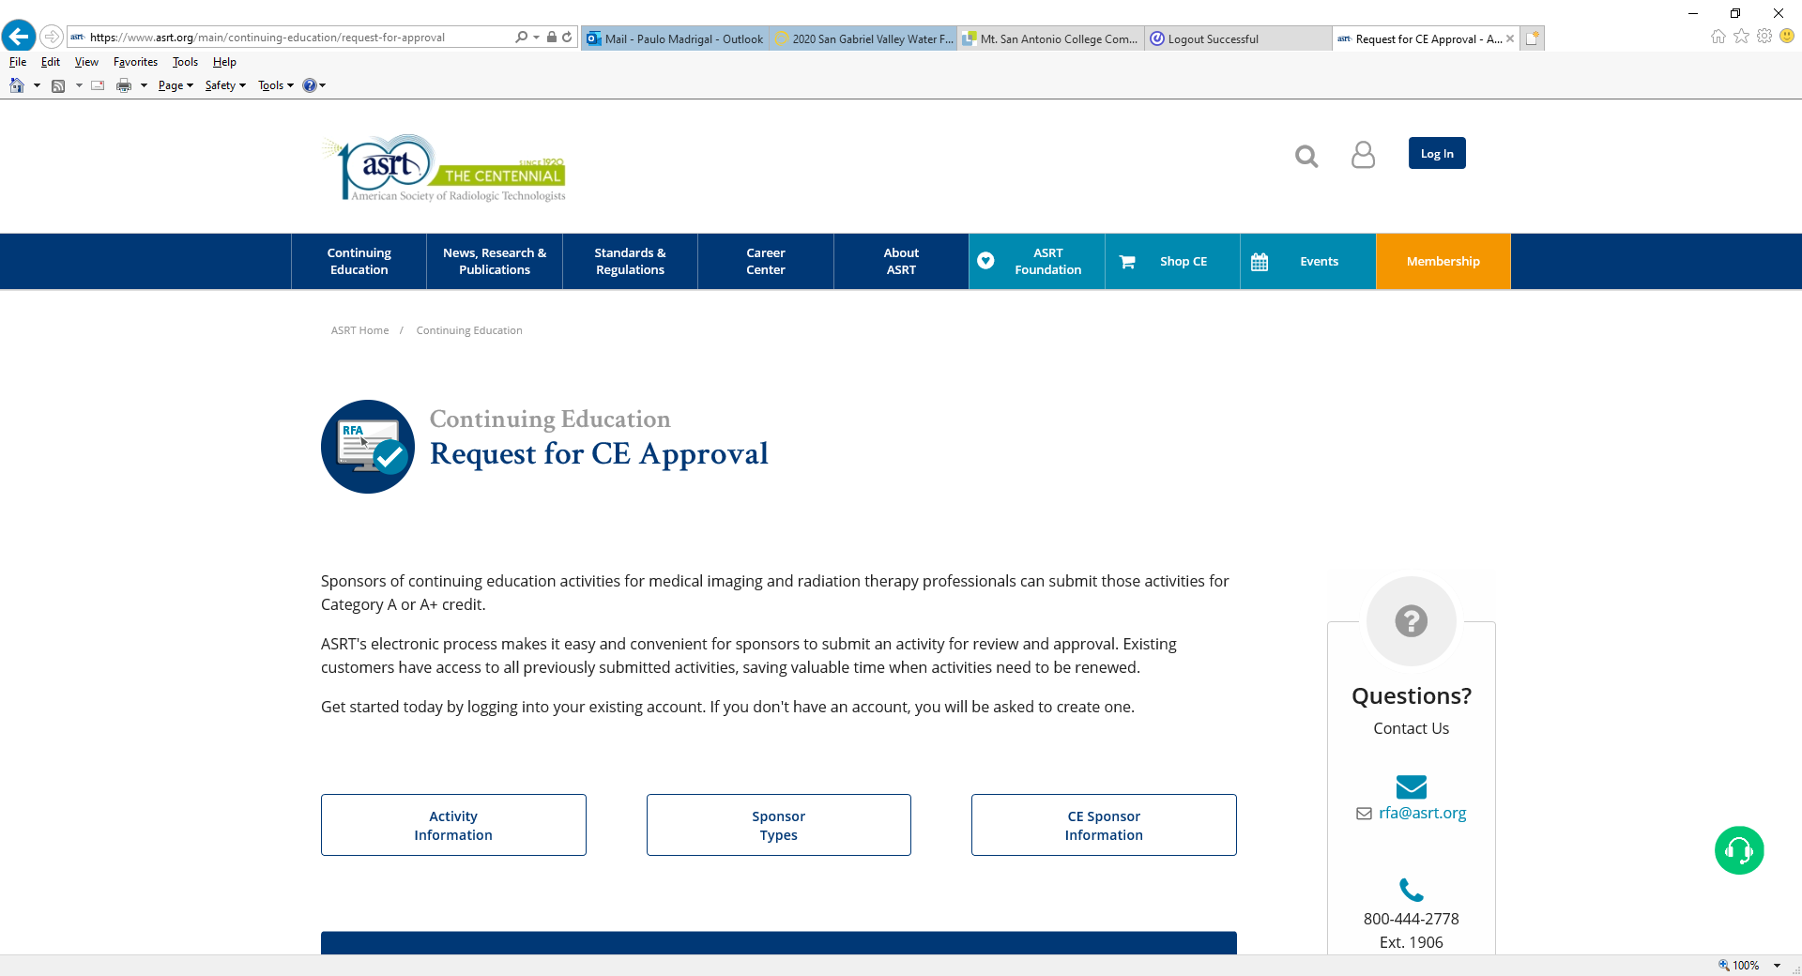
American Society of Radiologic Technologists (ASRT)
Principles of Computed Tomography

Slide 11
State Water Resources Control Board
Introduction to Water Systems
Water Distribution
Water Treatment
Cross Connection Control
SWRCB Specialized Training Providers

Slide 12
WWW.WATERBOARDS.CA.GOV

Slide 13
California Department of Public Health

Slide 14
Nurse Assistant Certification & Home Health Aides CNA/HHA

Slide 15
CNA & HHA CEUs Application

Slide 16
Language Courses: Advanced Hindi

Slide 17
Motorcycle Training

Slide 18
DMV DL389 Certificate

Slide 19
Partnerships that Work
Macaroni Kid
Charter School Vouchers
CourseHorse
Groupon
Laidlaw
NCTA: Private/Online/Out-of-State Test Proctoring

Slide 20
Macaroni Kid

Slide 21
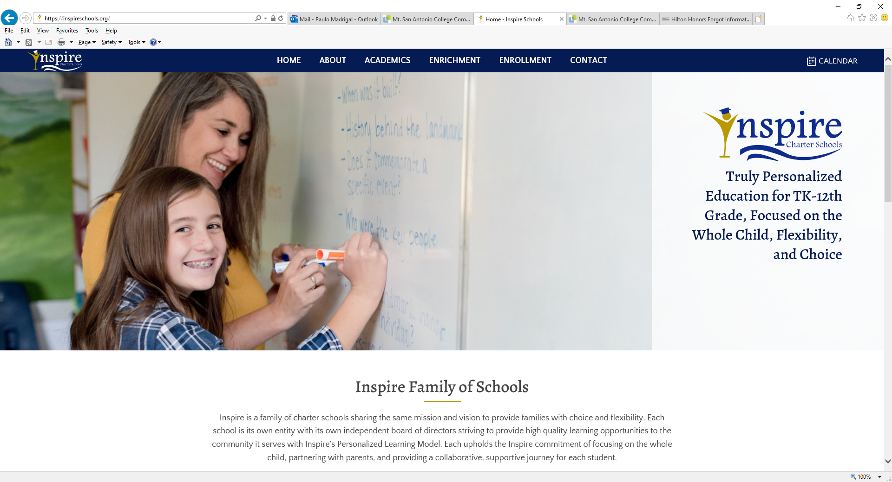
Charter School Vouchers
Children’s Choir
College for Kids
Violin

Slide 22
Coursehorse

Slide 23
Groupon

Slide 24
Laidlaw’s Harley-Davidson

Slide 25
Laidlaw’s Harley-Davidson

Slide 26
National College Testing Association

Slide 27
Questions?

Slide 28
THANK YOU! Paulo Madrigal Director, Community and Contract Education pmadrigal@mtsac.edu (909) 274-5234

