Slide 1
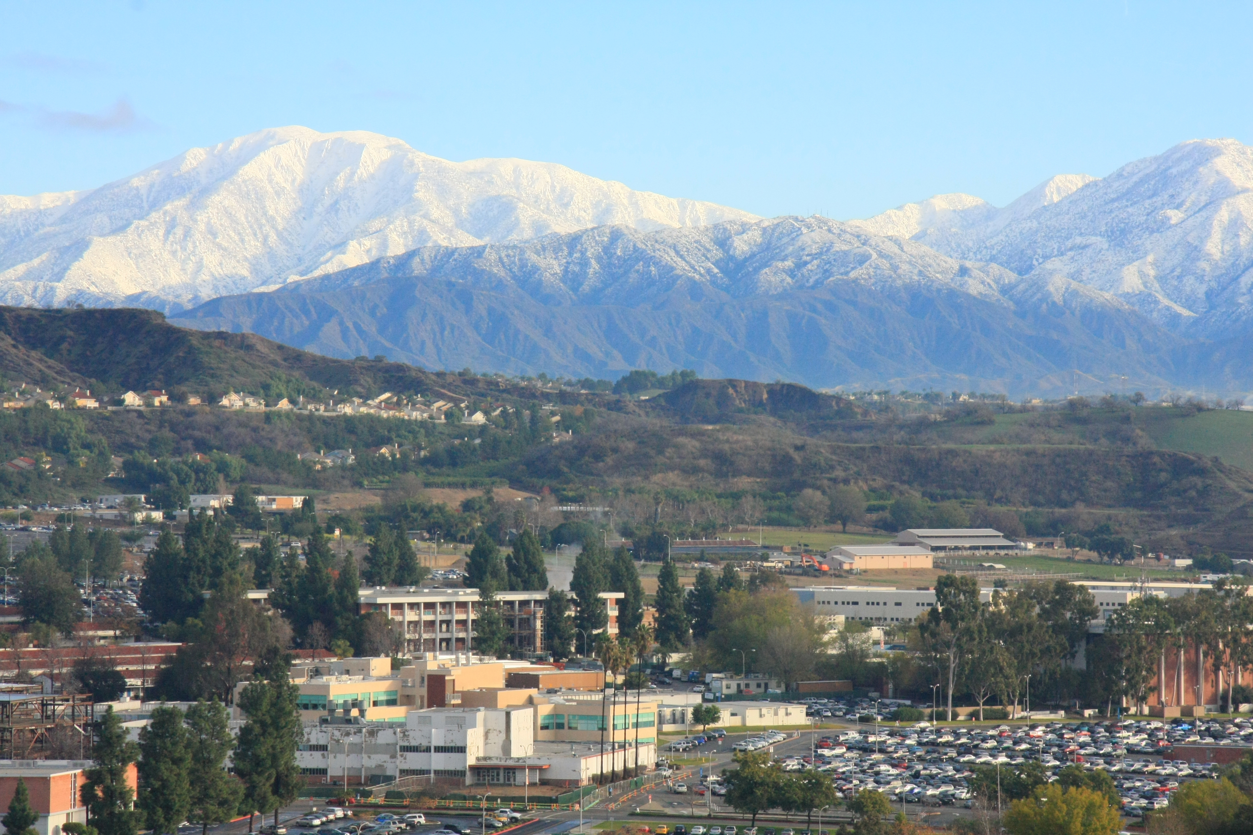
Mt. San Antonio College
Notes:
Campus from the air

Slide 2
Welcome Adding Test Proctoring Services to Your Community Ed. Programs Paulo Madrigal pmadrigal@mtsac.edu (909) 274-5234
Notes:
We are knows as Mt. SAC

Slide 3
Why a Fee Testing Center?
NOT an Assessment Center – We already have one
Searching for New Revenue
Diversification of Services
Community Need
Opportunity
Timing

Slide 4
First Year Stats
Number of Test Vendors: 6
Number of Tests Proctored: 3,380
Number of Unduplicated Test Candidates: 2,500
Staff Members: 3 Part Time

Slide 5
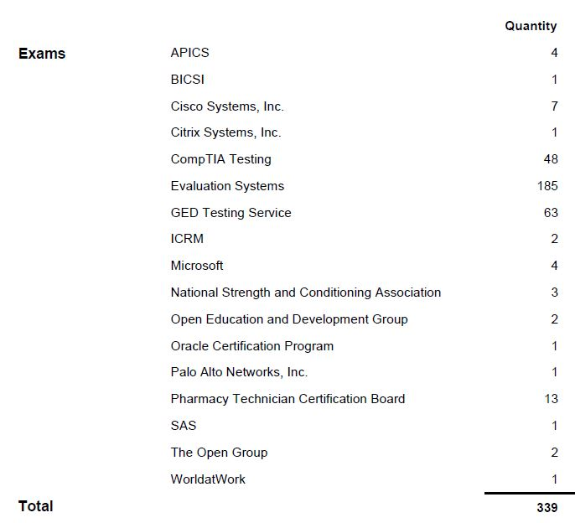
First Year Stats
Tests Delivered by Vendor
Castle/Scantron: 62
ETS HiSET: 141
ETS TOEFL: 252
Kryterion: 106
Pearson Vue: 2,819

Slide 6
Our Planning Check List
Research and Evaluation
Facility Planning
Vendor Agreements
Staffing
Training and Proctor Certification
Equipment
Daily Operations
Notes:
25 miles east of downtown Los Angeles

Slide 7
Research & Evaluation
Is there a viable market in our area
Which testing companies to partner with
Visit other Test Centers and learn from their experience
Technology Assessment: Computers and other equipment that meet vendor requirements
Location: Long term facility
Research which IBT tests are in high demand
Determine which tests we want to pursuit

Slide 8
Facility Planning
Workstation partitions are a MUST
The minimum center-to-center separation distance is 3 feet
Check-in area
Should be located near the entrance to the testing room in a separate area
Access for people with disabilities
Building, testing rooms, restrooms must be accessible to people with disabilities, including wheelchair access
Temperature controlled
Parking near the facility

Slide 9
Facility Planning
Separate waiting room for candidates
Should be provided next to or near the testing room
Restrooms
Should be located near the testing room
Lockers
Candidates are no allowed to bring personal belongings inside the testing room. Some comfort items are allowed
Document & equipment security
Secure place to store log sheets, important documents, and small pieces of equipment
All vendors have different requirements of items needed under lock and key

Slide 10
Vendor Agreements
MOUs vary in length of time and complexity (need Board approval)
Test security and test compliance is usually item #1
Proctoring fees vary from vendor-to-vendor
Different schedule flexibility (TOEFL only Fridays and Saturdays)
Some vendors require various trainings throughout the year (CATS requires face to face trainings)
Different software to deliver tests (proprietary and web based)
Different training and certification processes
ID requirements vary

Slide 11
Staffing
Test Center Administrator (TCA)
Responsible for running the test center
Proctor: Assist the TCA
Ratio of staff to candidate is about 15 to 1 for most
Depending on the vendor, you’ll usually need at least one TCA and one proctor to run the center
Vendors do not allow individuals in the testing area that are not certified/cleared by them
Every vendor lets you decide your hours of operation

Slide 12
Staffing
Record and keep track of certifications for each staff member
Certification renewal varies by vendor
Whenever possible, we require our staff to certify as a TCA rather than Proctor
Create a pool of TCA/Proctor prospects to allow for growth or in case someone gets sick/leaves

Slide 13
Training and Certification
Create and maintain a site training manual
Every staff member must pass certification for each vendor
Staff should be familiar with each procedural manual supplied by test vendors
Some vendors limit the number of TCAs for each site

Slide 14
Equipment
Computers
Headsets
Noise-cancelling headphones or earplugs
Calculators
Telephones
Camera/webcam
Tripod
Printer
Scanner
Electronic signature pad
Miscellaneous
Board cleaning material
Sanitizing supplies
Scratch paper
Pens and Pencils
Clip boards

Slide 15
Daily Operations
Schedule tests and staff approximately 6 months in advance
Staff should be scheduled to start at least 30 minutes before opening to make sure all systems are working correctly
Keep employee handbook and Vendor procedural manual handy
Make sure all systems are updated regularly to avoid technical issues (windows usually updates on Thursdays)

Slide 16
Daily Operations
Keep up with test schedules
Get organized with a “unified” Test Center calendar
Check daily for new/cancelled test appointments
Have an easy to find contact list for all vendors
Costumer service
Technical support
When calling costumer support have your site number and the candidate’s registration reference number ready

Slide 17
Tests by Vendor
Castle
CATS
ETS: TOEFL , HiSET
Kryterion
Pearson VUE
PSI/Comira

Slide 18
Useful Websites
Castle/Scantron (www.castleworldwide.com)
CATS (www.catstest.com)
ETS (www.ets.org)
Kryterion (www.kryteriononline.com)
NCTA (www.ncta-testing.org)
Pearson VUE (home.pearsonvue.com)
PSI/Comira (www.comiratesting.com)
TASC (https://tasctest.com)

Slide 19
Now What???
One year cycle completed
Evaluation
Growth?
Where?
When?
Other opportunities:
IELS
CATS
Private and Online Institutions

Slide 20
Some Fiscal Considerations
Are you producing enough income to maintain and expand your efforts
Can you roll income to the following year?
Funding for equipment replacement cycle

Slide 21
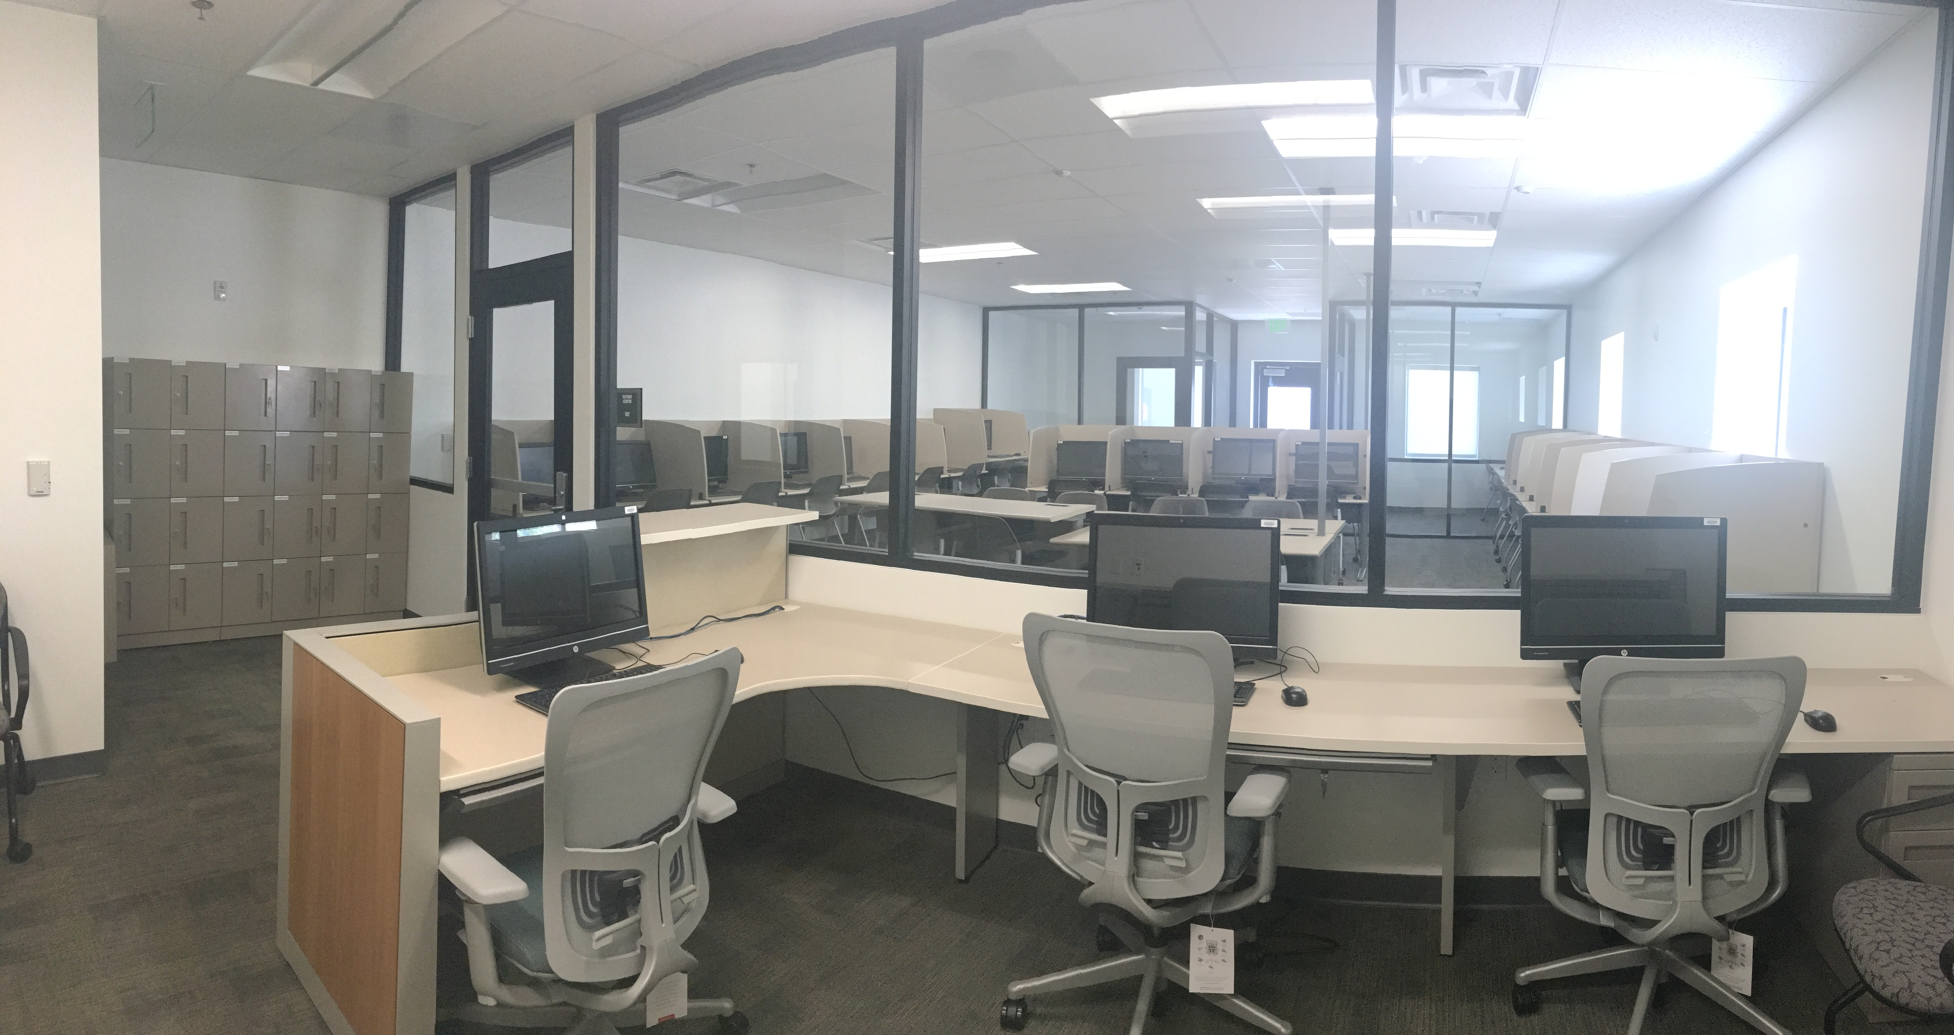

Slide 22
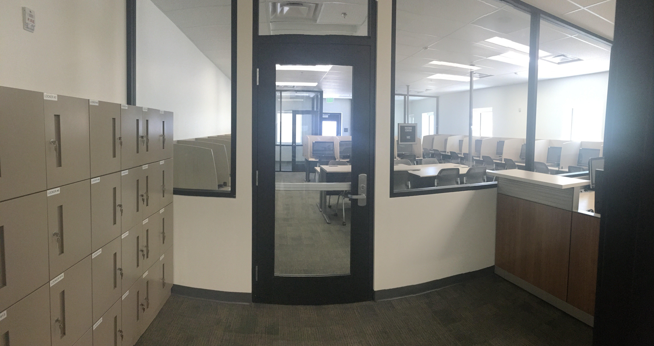

Slide 23
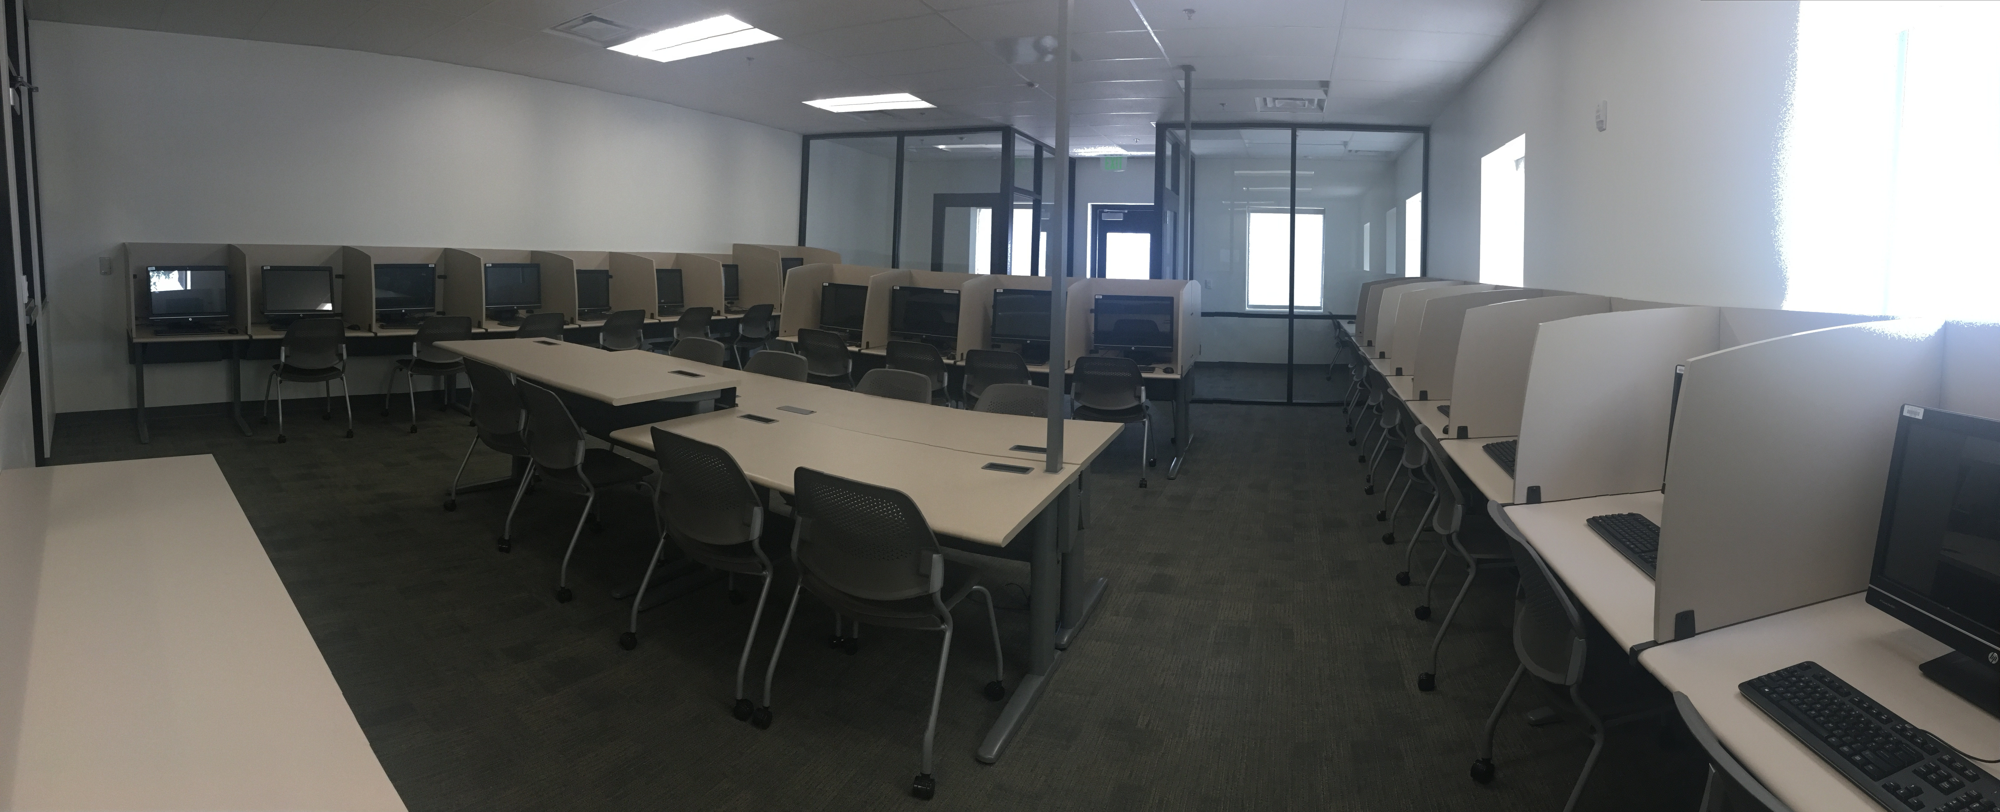

Slide 24
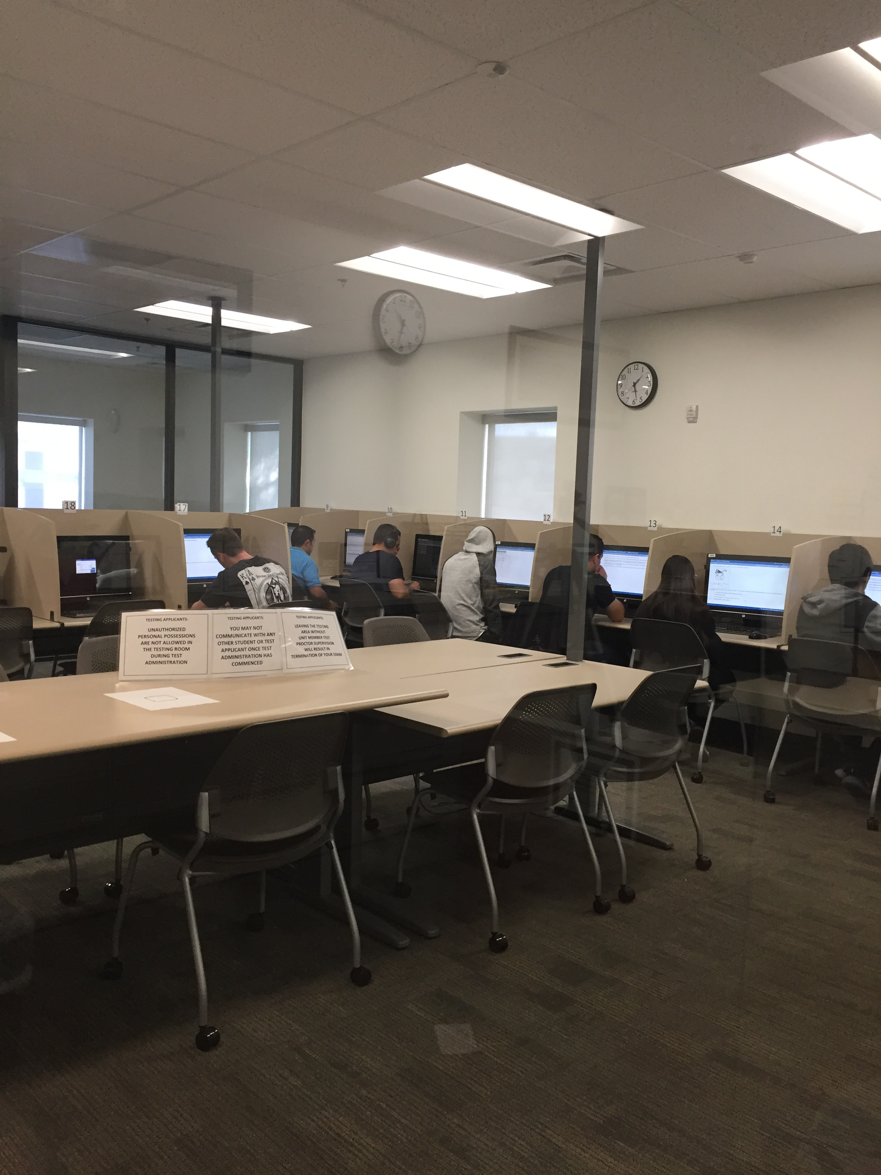

Slide 25
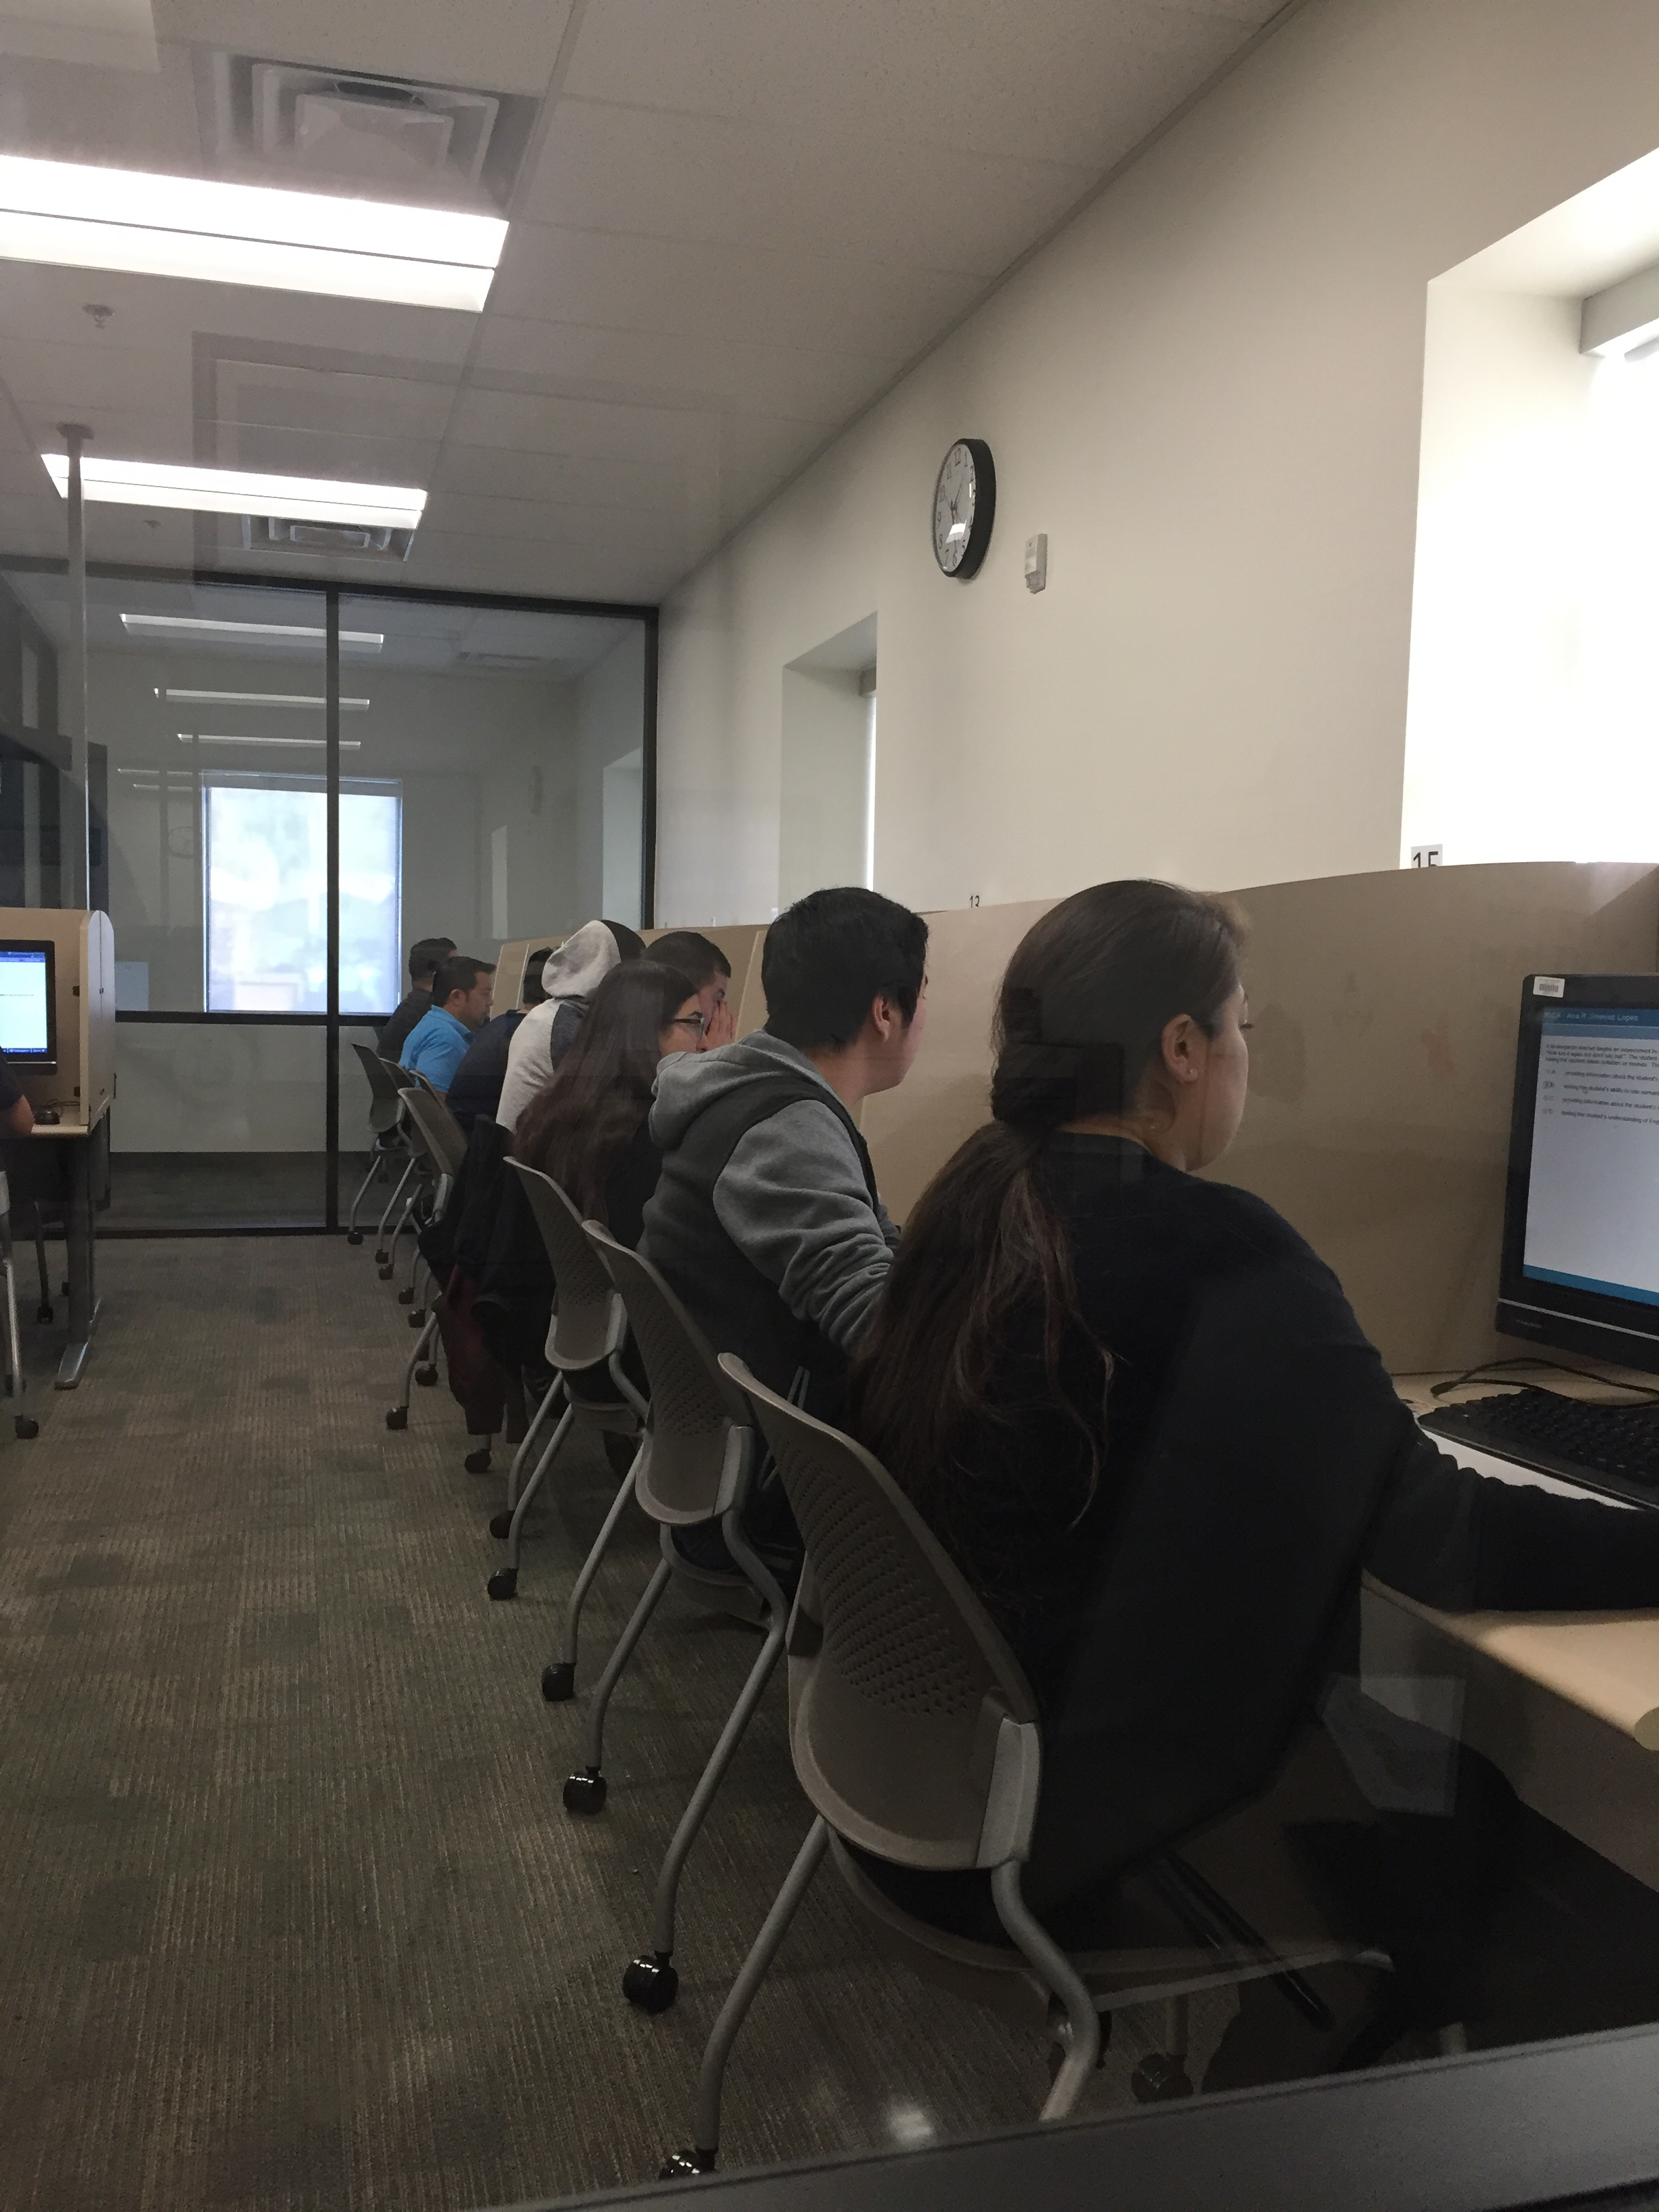

Slide 26
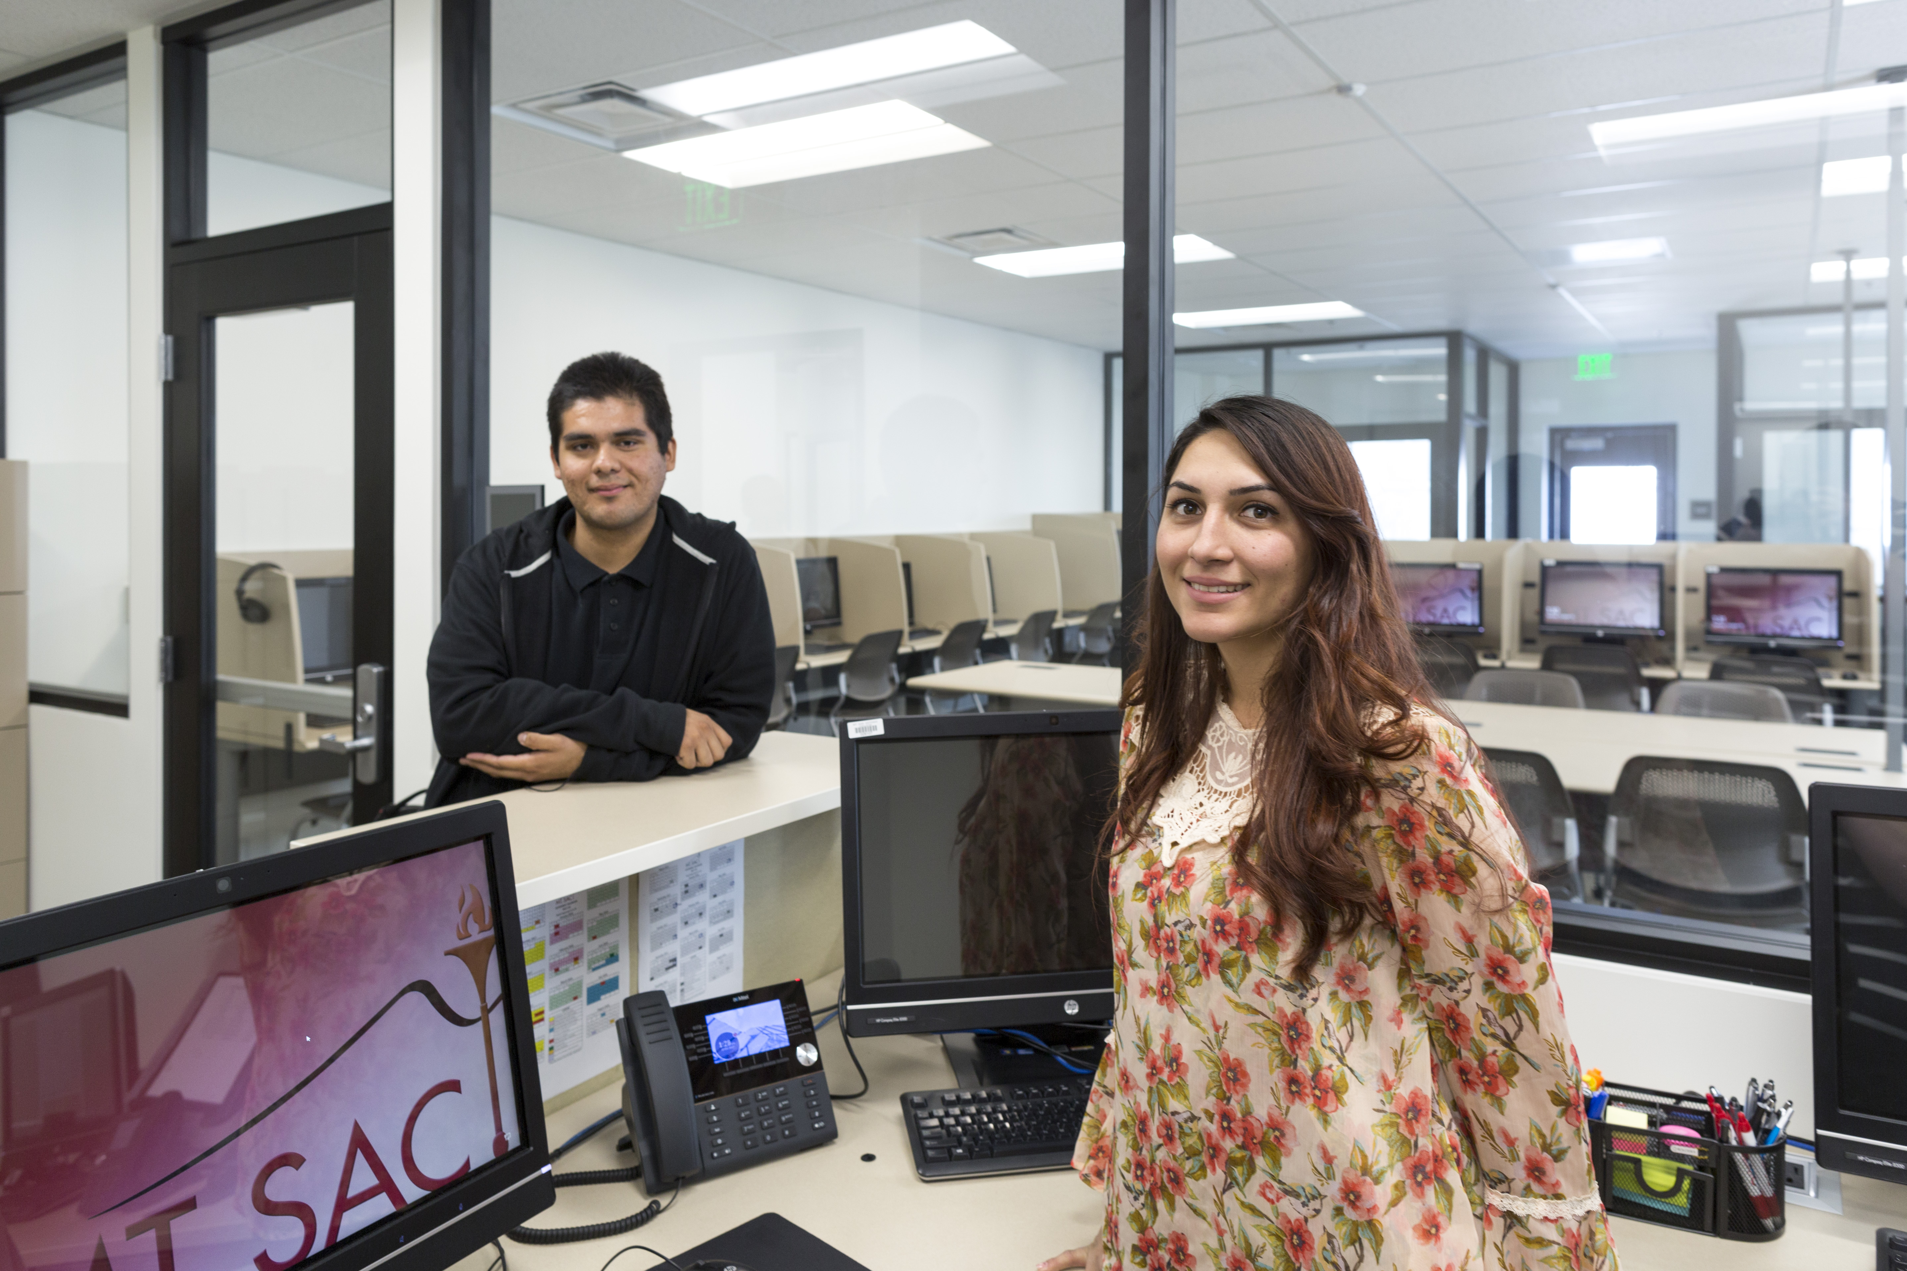

Slide 27
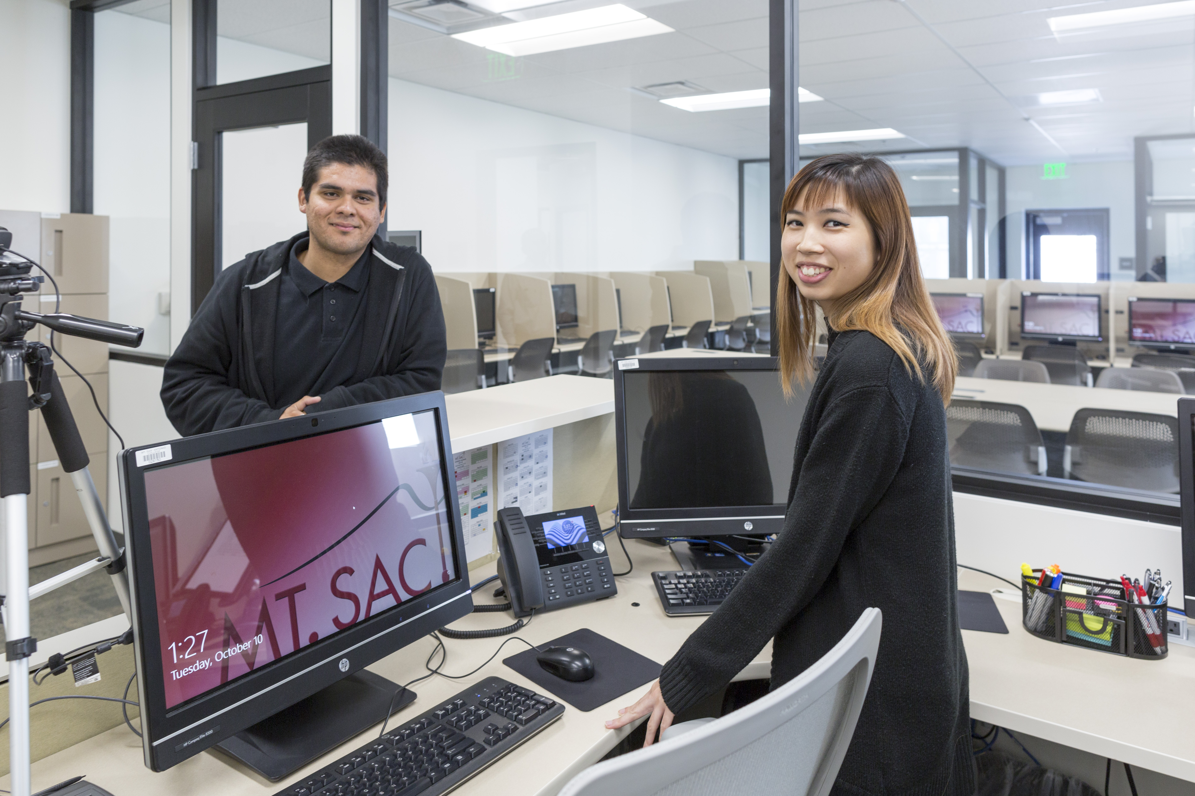

Slide 28
Questions?

Slide 29
THANK YOU! Paulo Madrigal Director, Community and Contract Education pmadrigal@mtsac.edu (909) 274-5234

