Slide 1
MANAGING THE MONSTER THAT IS THE SUMMER YOUTH PROGRAM
By Jackie Lorenz, Director
Diablo Valley College Community Education
jlorenz@dvc.edu
Notes:
This talk will walk you through my CE team’s one-year of preparing and delivering our 6-week summer youth program.
Throughout the talk, I will be opening up for you to share your own practices with the audience.

Slide 2
College for Kids
We are
Notes:
Pleasant Hill, CA – 45 min. NE of SF
College for Kids is under the Community Education department that also contains
Emeritus (Fall and Spring)
Adults and Families (Fall and Spring)
Other non-summer youth programs

Slide 3
OVERVIEW
30+ years
STEM, art, dance, languages, writing, drama
1,500 kids | 2 campuses
TWTH, between 12:30 and 4:30 p.m. for 6 weeks
50-ish instructors | 10-ish aides
$70 – 150 (9 hrs of instruction)
Notes:
Our schedule allows students to take:
3 different subjects in 3 wks or 6 different subjects in 6 wks
Gives kids more opportunities to explore different topics over the summer at one location
Parents want to expose their kids to extracurricular activities that can help their child find an interest that may develop into a career choice
What better place for kids to develop those career interests than at a college?
1500 non-duplicated; 2141 duplicated

Slide 4
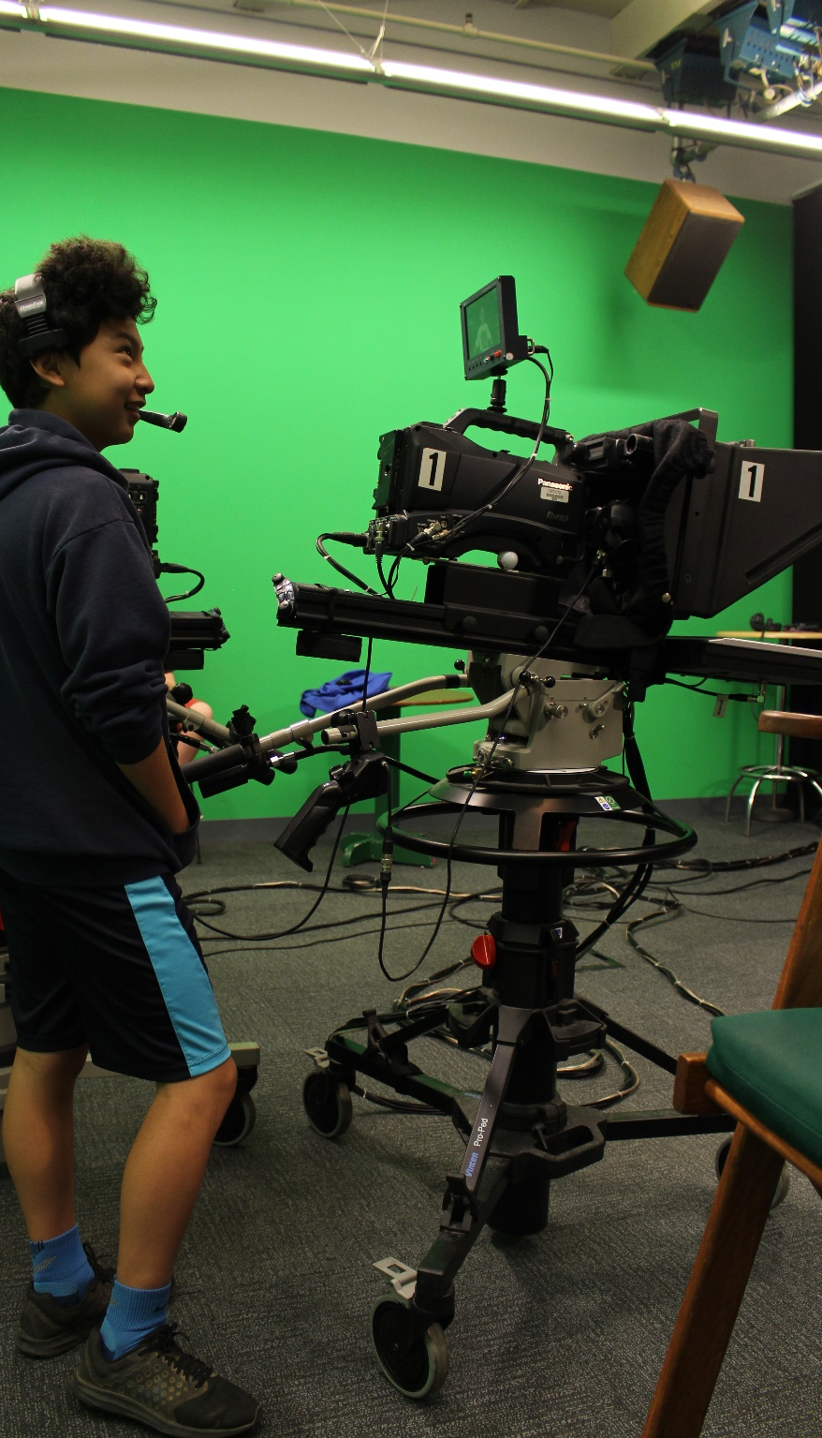
WHY OFFER YOUTH PROGRAMS?
Feeder
Outreach
Promotion
Revenue
Notes:
Should be THE messaging when promoting your program across campus.
WE ARE THE BEST OUTREACH TOOL.
WE ARE THE ONLY OUTREACH TOOL THAT MAKES MONEY FOR THE COLLEGE. YOU’RE WELCOME.
Feeder
Brings potential students and parents on campus
Parents are the ones who play a major part in their children’s first-choice college selection
Our programs allow youth to explore, at a low cost with short time commitment, many different areas of interest that can lead to making decisions in choosing a major and college
Outreach
We are the college’s best outreach tool
Hands-on experiences in areas that the college has degree programs in
EX: music production
Develops early relationship with parents who play a large part in college choice
Promotion
Builds word-of-mouth in the community
EX: College has TV Broadcasting program – families didn’t know we had this program
Revenue share
Generates revenue that can be used to help college departments with funding their small projects. MUST LEVERAGE THIS POWER TO RAISE CE PROFILE.
EVERY NEW CLASS OR EVENT YOU PUT TOGETHER SHOULD HAVE A VERY CLEAR LINE TOWARDS THE COLLEGE’S MISSION AND GOALS. THAT WAY YOUR WORK IS INDISPUTABLE.

Slide 5
One Year
6 weeks
Notes:
We take one whole year to plan for six weeks of programming.
80% of successful delivery during those 6 weeks happens before it even starts.
Planning
Revising procedures
Analyzing data
Improving communication with families and instructors
Recruiting quality instructors

Slide 6
WHAT WILL BE COVERED
Post
Prep
Recruitment
Marketing
Delivery
R & D
Notes:
12-month cycle
It’s our biggest program, it gets the most attention and resources, but we are still able to develop and support our other two programs in the fall and spring

Slide 7
POST
Post
Survey
Debrief
August - September
Notes:
Yay, the camp is over! We don’t have to think about it again for 6 months!
WRONG!!
It’s tempting to put the youth program that just completed onto the back burner, but it’s important to do a few things while everyone’s memory is still fresh.

Slide 8
POST
Inventory
Admin Wrap-Up
Report
Notes:
POST
Inventory supplies & save file in shared drive
Store and purge supplies/equipment
GET HOUSEKEEPING ITEMS OUT OF THE WAY.
Key support staff wrap-up any loose ends (ex: dropping all students from canceled classes, processing refunds, etc.)
Quick report – 30,000 ft view of the summer
Enrollments up, same, down?
Revenue up, same, down?
Class cancellation rate?

Slide 9
SURVEYS
10 Qs
Short
Ratings
Comments
Ratings
But allow for optional follow-up by staff
Anonymous
Notes:
SURVEY
Within a month or 2 of program ending, survey families, instructors and staff
Short, 10 questions
Rating system (1 – 5) and include space for comments
Keep it anonymous, but allow for optional follow-up from the staff

Slide 10
DEBRIEF
1 hr
3 – 5 key players
The good
The bad
Improvements
Action
Notes:
DEBRIEF
September/early October
Conduct a debrief with key members of team (core office team, seasonal leads, one or two instructors).
No more than 5 participants in debrief. – 1 hr
Share survey results – highlight only what received the highest and lowest marks
What went well
What did not go well
Action items to get improvements developed and in place by determined deadlines
Assign action items to team players
If applicable, conduct debrief with key campus staff (police services, etc.) – 30 min

Slide 11
PREP
Procedures
Discuss monthly
FYIs and FAQs
September - March
Notes:
NO NEED TO PUT THESE OFF UNTIL WHEN THEY’RE NEEDED!
Update procedures manual, policies/procedures, etc. based on all info gathered from debriefs, surveys, etc.
Update parent packets, release forms, instructor packets, FAQs, web pages, course descriptions, etc.
MEETINGS
Meet 1 hour each month to lay the groundwork for successful program delivery
Starting 2 months out, have weekly meetings

Slide 12
BUDGET
October
CSI students collecting evidence
Notes:
Our fiscal year is from November – October If your fiscal year isn’t this, you must make it this. THIS IS THE REAL REPRESENTATION OF YOUR PROGRAM’S DATA.
Reconciliation of previous year occurs in October with accounting representative at college
Final revenue and costs determined
Operating budget determined
Funds to invest in program determined
Now you know your operating budget AND YOU CAN START R&D!!!!!!

Slide 13
ALLOCATION
Misc 6%
Seasonal 45%
Supplies 3%
Marketing 2%
Staff 30%
Scholarships 2%
of funds
Notes:
Many CE programs are revenue-generators for their college. YOU NEED TO GET THAT MESSAGING OUT!
For us, we provide the college with 40% of our NET.
Scholarships $2500 (18 students)

Slide 14
Magnifying glass review of the summer
DATA ANALYSIS IS HERE & IT IS CRITICAL TO YOUR PROGRAM’S SUCCESS
Really dig into the data from your summer
What classes had the best ROI? The least?
Have costs increased enough to raise fees?
Notes:
Build on success maybe level 2 or more offerings?
RELEASE the dogs!
Hard data is indisputable

Slide 15
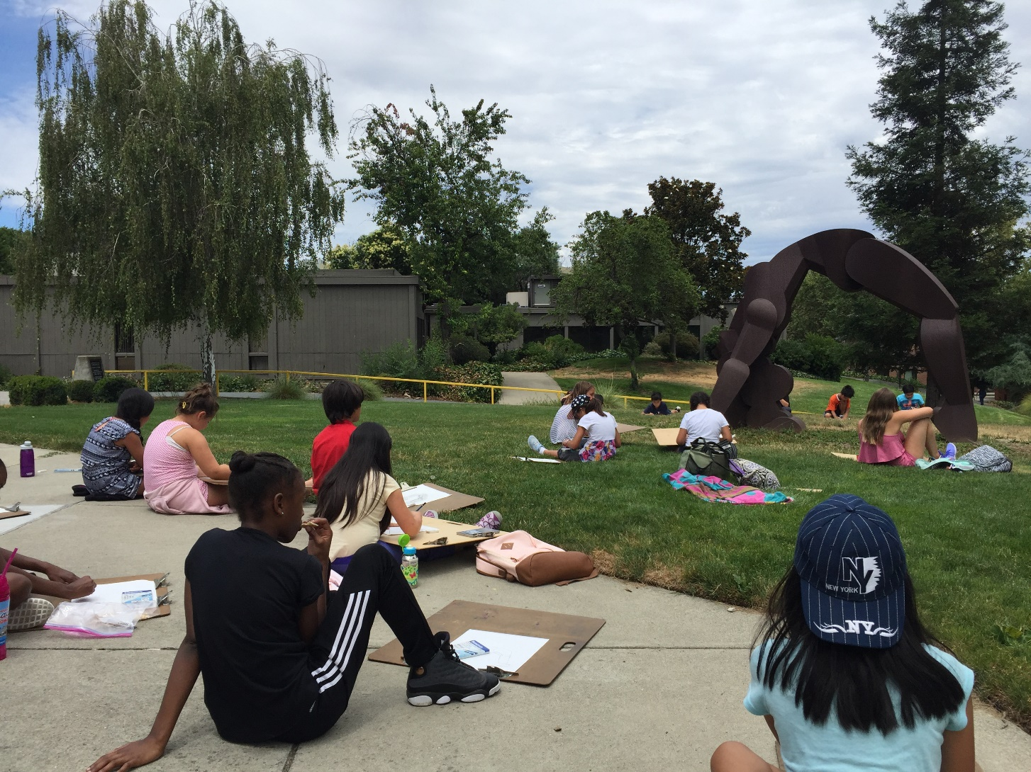
Research & Development
Read everything
Social media
Campus facilities
Be curious
Student clubs
Community e-newsletters
Department meetings
Drawing students getting inspiration from the campus
Notes:
Read campus paper, local papers, search camps across the nation, search for trends in STEM and the arts, read magazines local and national
Read your college’s catalog
Instagram and YouTube are fun and easy ways to learn about new tech that can be helpful in planning classes
Know your campus and classrooms (TV broadcasting)
Be curious, enjoy learning about different things, have a passion for what’s new
Attend department and faculty meetings
Research on-campus student clubs
Sign up for community e-newsletters

Slide 16
Notes:
Have a campus newspaper? Have a journalism camp!

Slide 17
FINAL DEVELOPMENT
Finalize class offerings
Build online catalog
Complete brochure
Book classrooms
Put in IT requests for software installation
“Can” e-newsletters and have marketing materials ready to go
Notes:
Taking all the data we collected from surveys, debriefs, data-mining and analyzing:
Finalize class offerings:
Did we build on success?
Drop the dogs

Slide 18
BE AWARE OF CONSTRUCTION PROJECTS!
Notes:
Make sure you are in the loop on construction projects that may impact your programming
SRC example
Loss of 2 classrooms = $10,000 in revenue loss

Slide 19
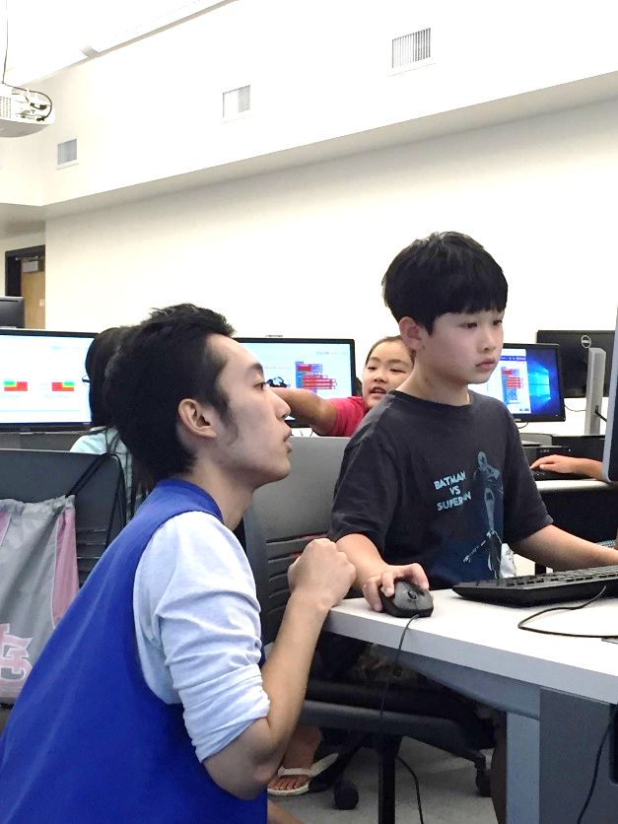
Post
Prep
Recruitment
Marketing
Delivery
R & D
Aide helping student during Coding & Robotics
Notes:
What I’ve covered so far.

Slide 20
RECRUITMENT
Faculty
Instructor network
Public schools
Student clubs
College’s job site
Job fairs
October - April
Notes:
BEST RESPONSE RATE – already familiar with campus, program, and vetted by instructors you trust
Instructor network
Public schools
Faculty
Talented students
Student clubs
LOW RESPONSE RATE – Job fairs do not really satisfy any of the above. I’m happy to have a presence at very targeted job fairs every two years. Stick to nearby universities that host job fairs specifically for teachers, if possible. Also, if there is a recreation program at a university with a job fair, attend that as well.

Slide 21
MARKETING
January - May
Notes:
GETTING THE WORD OUT
January
Email families registration dates and summer dates
February
Email summer brochure
March
Mail printed brochure
April – May
Email families once or twice a month

Slide 22
Canva.com
https://www.canva.com/ They have free video tutorials. This is FREE at the basic level.
Notes:
Don’t have support from college’s marketing department?
Don’t have a graphic designer?
Use Canva.com

Slide 24
DELIVERY
April - July
Notes:
Scholarship recipients notified
Registration opens in April
Family orientations
Instructor orientations
Basecamp
Emails to families with important info

Slide 25
Scholarship info
Email we send regarding scholarship
Notes:
Email families a reminder of registration date
staff will be inundated with phone messages and calls
our online registration system will be overloaded

Slide 26
REGISTRATION BEGINS
Email we send families prior to registration start
Notes:
Email families a reminder of registration date
staff will be inundated with phone messages and calls
our online registration system will be overloaded

Slide 27
Parent Packet
Parking
Checklist
FAQs
Map
Letter from Police Services
Parent Packet 2018
Notes:
Getting important info out to families week of

Slide 28
Parent Checklist
Child’s summer schedule
Purchase supplies
Medical and Accommodations reminder
Important contacts saved on smart phone

Slide 29
FAQs
Dropoff/pickup procedures
Early pickup
Refund policy
Snack breaks
Absences
Behavior issues

Slide 30
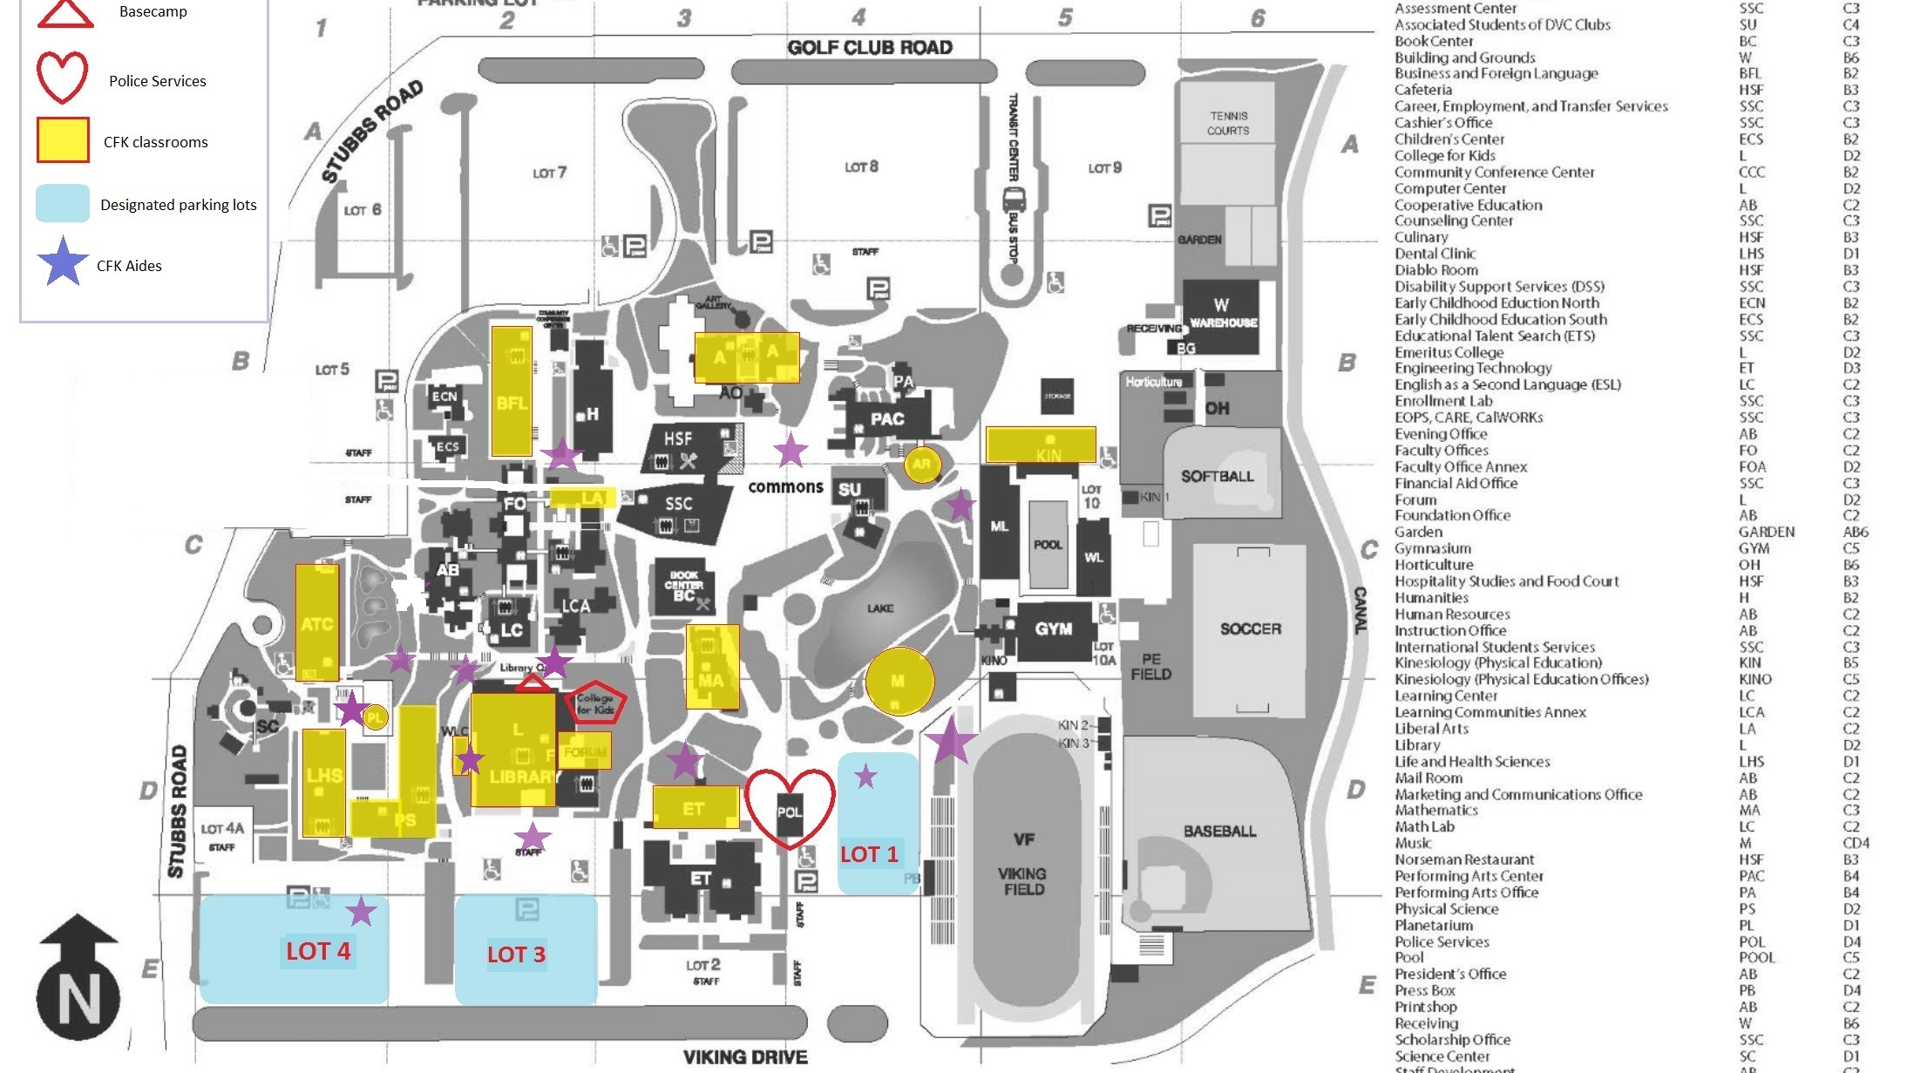
Notes:
Create a program-specific campus map to make it easier for your families to find the program highlights.

Slide 31
Family Orientation
Staff
First day
Map
During camp
Getting ready
Campus tour
Refund policy
Family Orientation PowerPoint 2018
Notes:
200 registrants per year
Charge $2.50

Slide 32
Instructor Packet
Parking
Time entry
FAQs
Map
Troubleshooting
Payroll
Accessing roster
Notes:
Don’t do it all!
HR questions – go to HR
Payroll questions – go to Payroll
The money we make for the college goes to those services.

Slide 33
Instructor Orientation
Parking
Walkthrough accessing rosters online
Backup for when technology fails
Pickup supplies and handouts
Complete paperwork
Staff
Lesson plans filed in main office for days missed
CFK Instructor Orientation PowerPoint 2018
Notes:
MANDATORY & PAID
Invite department leads to orientation
Police Services
IT
Payroll

Slide 34
WEEK BEFORE
Notes:
Take a walk around campus
Have signage ready for posting
Have copies of maps, classroom info, parking passes ready
Email campus notice of summer program start

Slide 35
DAY 1
BASECAMP
Staffed with 2 aides
Maps
Classrooms list
General questions
Basic registrations
Triage
STAFF
Aides check in and pick up their equipment and go to their stations around campus
Main office is fully staffed and prepared to assist instructors, troubleshoot, and register dozens of kids
Policies, procedures are available to main office staff
Parent Packet 2018

Slide 36
Main office
Notes:
Have a gatekeeper stationed outside office entrance
Redirect, if applicable
Answer quick questions
Only allow instructors and families with urgent and complicated issues into main office for assistance
Designate an instructor liaison
Set up area for instructors to pick up copy requests and basic supplies

Slide 37
During the program
Monitor enrollments and waitlists daily
Instructors track attendance (families know that we are not able to report absences to them in real time)
Communicate with families via email when appropriate
Communicate with instructors via email when appropriate
Manage staffing
Have a substitute list ready
Allocate resources where needed
Keep instructors, aides and staff hydrated and fed
Plan a mid-way potluck for instructors and staff OR keep it simple and have pizza delivered
Respond to complaints, concerns in a timely manner
Notes:
Override refund policy when necessary
Give override power to staff

Slide 38
Toot Your Own Horn!
NO ONE IS GOING TO DO IT FOR YOU!
Take one or two days out of your year to create an annual report that is more fun to read than text and charts.
TAKE PICS!!!!!
Shameless self-promotion!!!
https://www.dvc.edu/business/communityed/pdfs/CE1718AnnualReport.pdf
Notes:
President requested copies to share with board
Share student work: magazines, pics of their projects

Slide 39
Planning, Development, Delivery of our Emeritus and Adults and Families CE programs
Planning, Development, Delivery of our College for Kids program
Notes:
HOW WE ARE STAFFED OVER THE YEAR (below) AND ALLOCATION OF 3 MAIN OFFICE STAFF HOURS (above)
August – March
3 part-time employees only
April - May
4 part-time employees
(we add 1 part-time staffer to assist with frontline support, registrations and prep)
June – July
4 part-time office staff
50 instructors
10 aides
1 off-campus coordinator

Slide 40
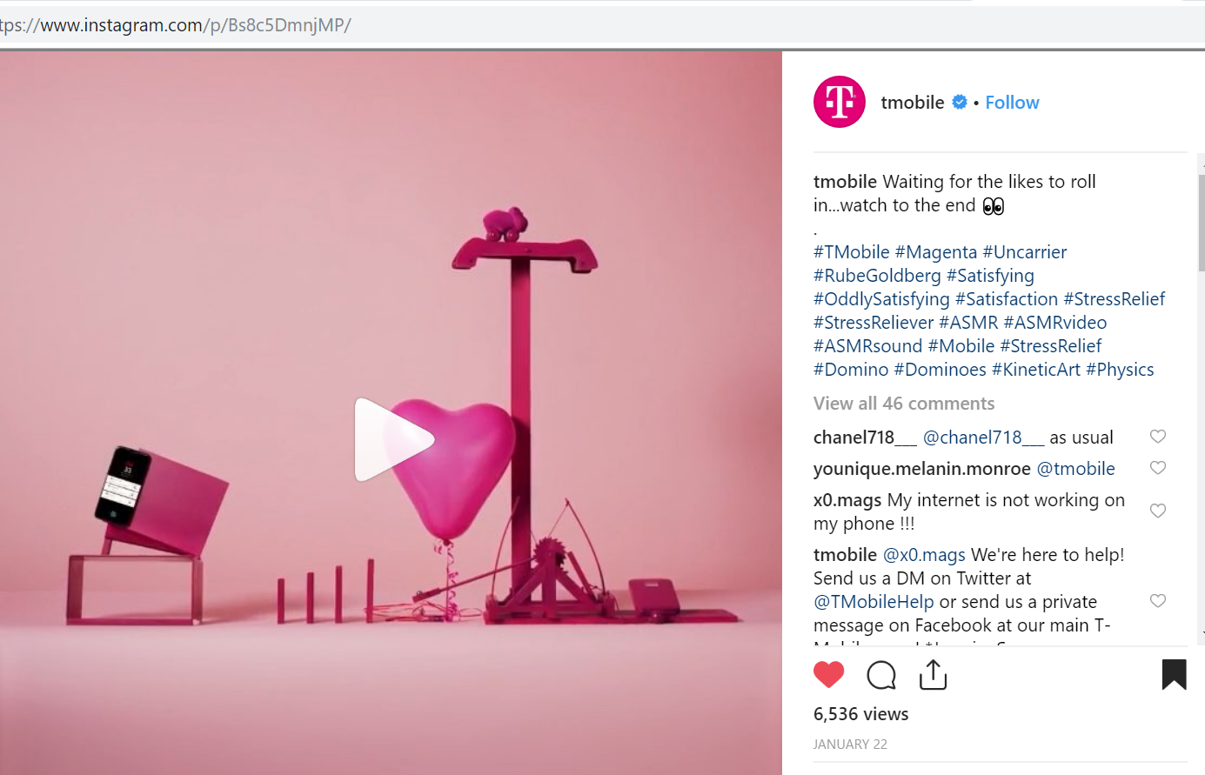
Instagram
Notes:
This isn’t the Instagram source that inspired our MakerSpace camp last summer, but it is a good representation of what our students worked on, which are Rube Goldberg machines.
MakerSpace Camp
SLOs
Engineering
Creative problem-solving
Team work
Physics

Slide 41
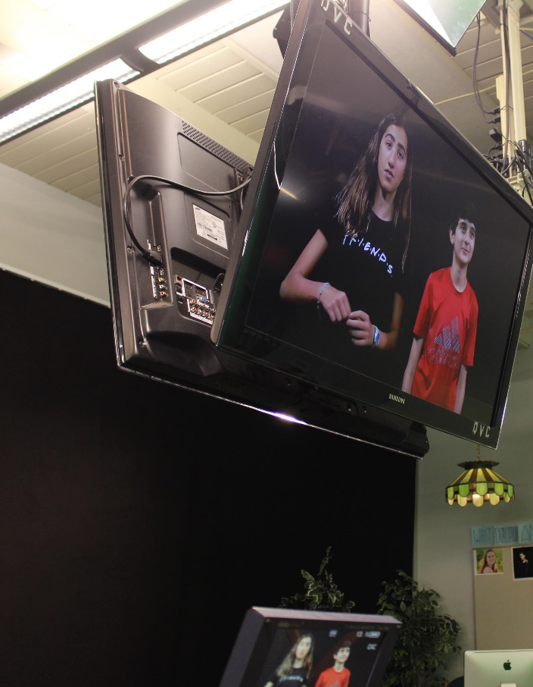
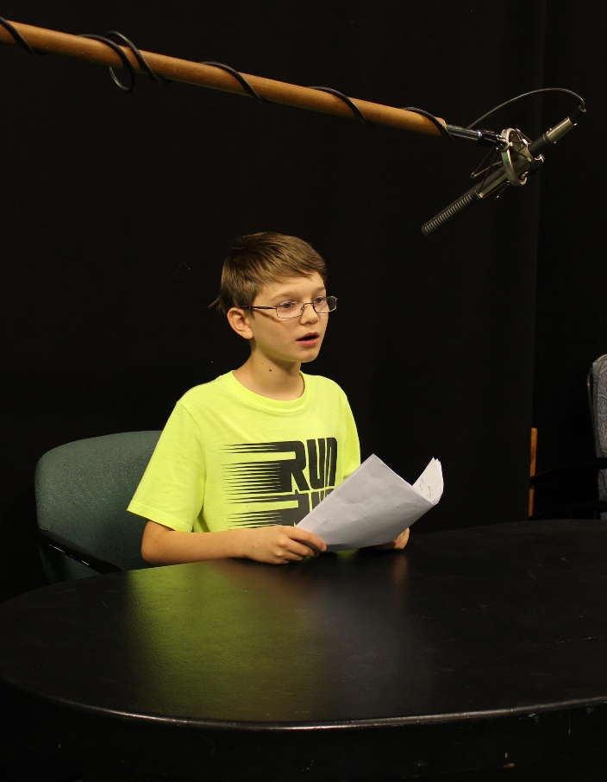
TV Broadcasting
Notes:
Share college program links in your online marketing https://www.dvc.edu/academics/cte-brochures/film-tv-electronic-media-brochure.pdf

Slide 42
FREE-sources
https://www.acacamps.org/
Instagram
Follow who inspires you
National Geographic
Pixar
Lego
Nasa
TED and TEDx
Juilliard
Streetartglobe (not always safe for work so don’t follow on department’s Insta account)
Follow your competitors’ and local Insta-accounts
Follow all of your college’s Instagram accounts
Canva.com – FREE!!!!!!!
Constant Contact
rSchoolToday (our registration system) - https://diablo.cr3.rschooltoday.com/public/home
Parent packet
Instructor Orientation Presentation
CE annual report
Your college catalog

Slide 43
Email we send families to give them a heads-up about the first week of registration
CFK scholarship email
CFK brochure announcement email

