Slide 1
CAEP Update
ACCE Drive-in
November 12, 2020
Neil Kelly

Slide 2
Agenda
CAEP Summit
3 year plans & goal setting
19-20 preliminary state data
Communities of Practices / Interviews
AB705 & other Transition Efforts
Recent survey data
Open Discussion

Slide 3
CAEP Summit
Over 1200 people registered
Still working on the evaluations
Virtual Summit platform will stay open for the next few months
Working on packaging the various strands and topics for your viewing pleasure.
Summit for 2021 will also be virtual – but same month – October
CAEP Office set the record for most people on a panel!!!!

Slide 4
3 year plans & goal setting
Guidance will roll out in the Spring 2021
Plans will be due June 2022
Process will include goal setting
You may update your current 3 year plan (if you wish) or create a brand new plan (but the plan is for regional use only).
State will require the submission of goals/targets into NOVA
Still working on the details. More to follow
But be prepared!!!

Slide 5
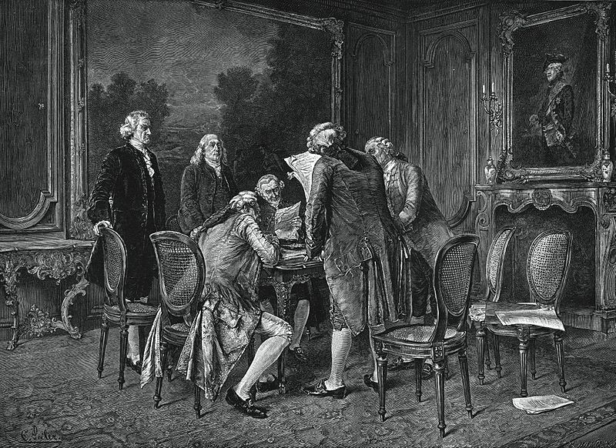
19-20 preliminary State CAEP data
Only TOPSPro student data available right now for 19-20
COMIS data will be coming in over the next few months
LaunchBoard will display 19-20 student data by March 2021
So far, 10% drop in CAEP enrollment compared to 18-19
WIOA II funded colleges show a 12% drop from 18-19
Enrolled CAEP students reaching 12 hours of instruction or more – 68.8%
Of those w/ 12 hours or more – 37% completed one or more Educational Functioning Level.

Slide 6
Communities of Practice
Gathering information on who’s doing what, and how they are doing it, and if they are any good at doing what they are doing.
Summit Presentations
Hanover Research & Guided Pathways
High Road Alliance & Transition / I2
SCOE TAP

Slide 7
AB705 & other Transition Efforts
Along with Communities of Practices – we will be having professional development events/webinars on the following transition efforts ( and more)…
Dual Enrollment | Guided Pathways
Co-Enrollment | Integrated Education & Training
Pre-Apprenticeship | Immigrant Integration
Competency Based Education | Pathway Mapping

Slide 8
Recent Survey Data
West Ed survey of noncredit faculty & staff – over 1000 responses from close to 80 community colleges.
Survey was done in May / June of 2020
CDE survey of WIOA II and later CAEP agencies – 147 agencies responded.
Survey started in April and was extended to August of 2020.

Slide 9
Any Questions?

